Slide 1
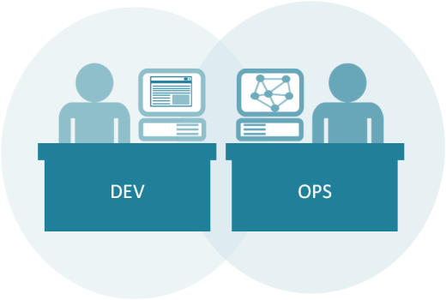
Introduction to Kubernetes
64300M_2.0_2018

Slide 2
Welcome!
Logistics (breaks, facilities, lunch, etc.)
Rules of Engagement
Introductions
Let’s Get Started!

Slide 3

Who is your instructor?
A little about me…

Slide 4
Introductions
What is your Name and Job Role?
Your company or team?
Expectations for the class?
Something interesting about yourself?

Slide 5
What to expect from this class
Flexibility
Conversations
Literacy and awareness on many of the principles, tools, and practices surrounding Microservices culture, architecture and implementation.
An effort to focus on your own situations and challenges so you can act on what you learn.

Slide 6

Introduction to Docker

Slide 7
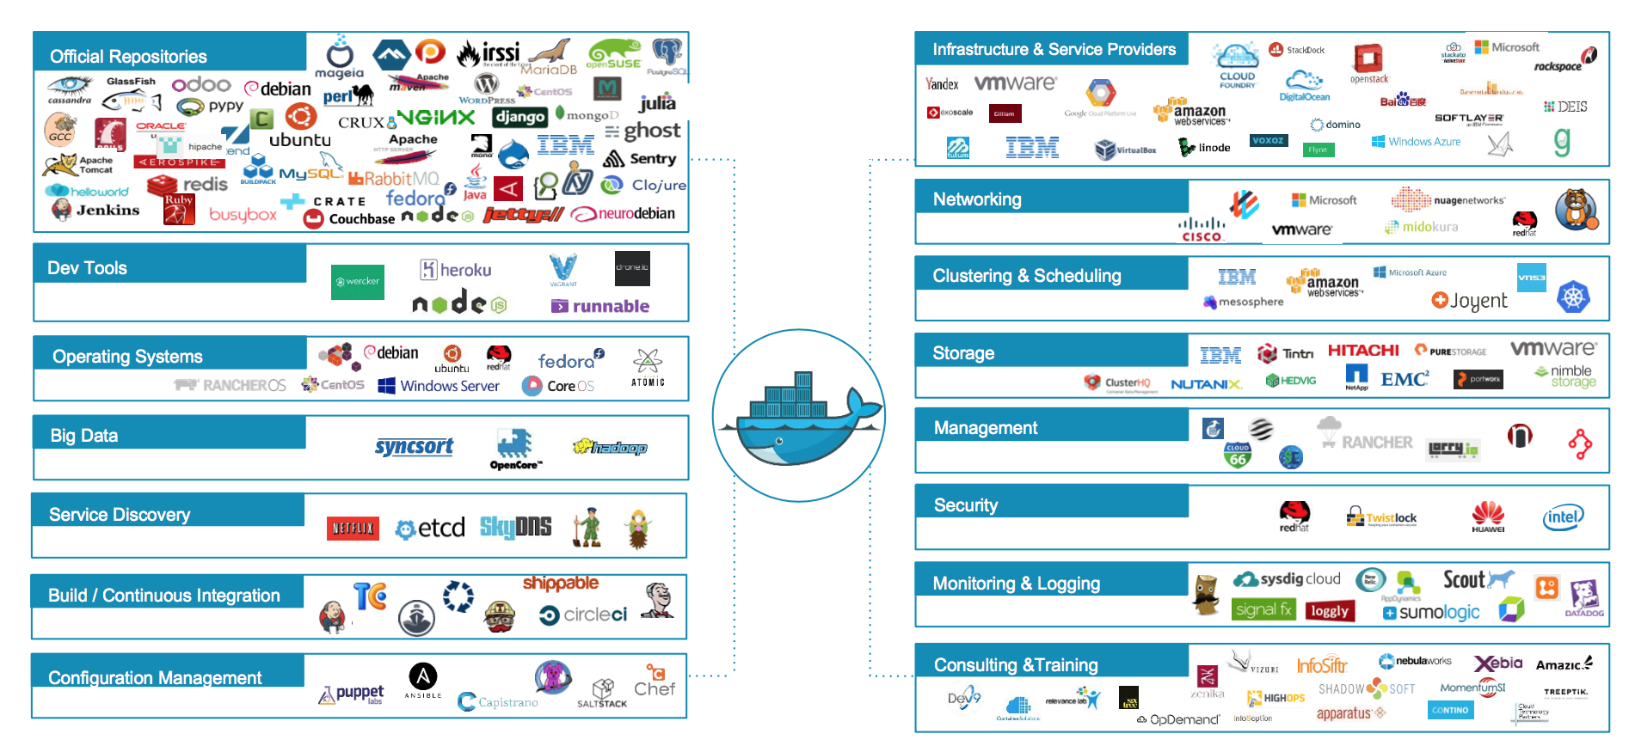
Docker ecosystem
Notes:
Official Repositories - These are repositories of popular commercial and open-source software and systems that are maintained by their “Official” providers. THese undergo special vetting, static analysis for malware, and are usually among the best-documented container images.

Slide 8

Docker Basics
Docker Image
The basis of a Docker container
Docker Container
The standard unit in which the application service resides
Docker Engine
Creates, ships and runs Docker containers deployable on physical or virtual host locally, in a datacenter or cloud service provider
Docker Registry
On-premises registry for image storing and collaboration
Notes:
A Docker image is a read-only template with instructions for creating a Docker container. For example, an image might contain an Ubuntu operating system with Apache web server and your web application installed. You can build or update images from scratch or download and use images created by others. An image may be based on, or may extend, one or more other images. A docker image is described in text file called a Dockerfile, which has a simple, well-defined syntax.
A Docker container is a runnable instance of a Docker image. You can run, start, stop, move, or delete a container using Docker API or CLI commands. When you run a container, you can provide configuration metadata such as networking information or environment variables. Each container is an isolated and secure application platform, but can be given access to resources running in a different host or container, as well as persistent storage or databases.

Slide 9
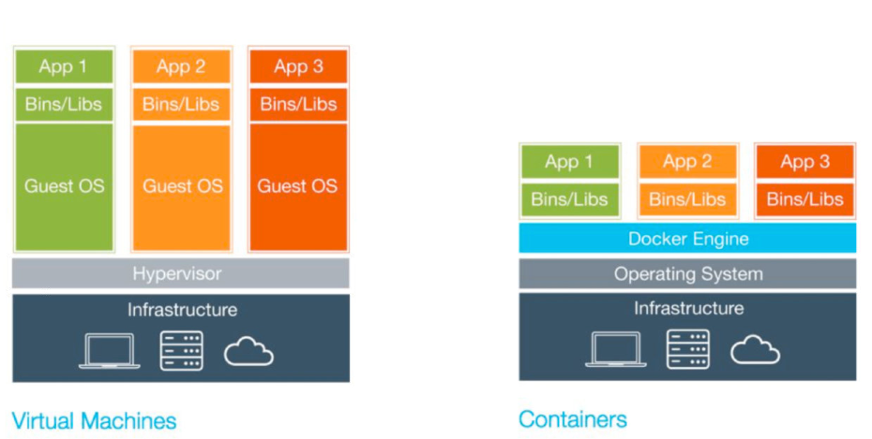
VMs vs. Containers

Slide 10
VMs vs. Containers
Virtual Machines (VMs) | Containers
Represents hardware-level virtualization | Represents operating system virtualization
Heavyweight | Lightweight
Slow provisioning | Real-time provisioning and scalability
Limited performance | Native performance
Fully isolated and therefore more secure (maybe) | Process-level isolation and therefore less secure (maybe)
Notes:
Size: VMs are very large which makes them impractical to store and transfer.
Performance: running VMs consumes significant CPU and memory, which makes them impractical in many scenarios, for example local development of multi-tier applications, and large-scale deployment of cpu and memory-intensive applications on large numbers of machines.
Portability: competing VM environments don't play well with each other. Although conversion tools do exist, they are limited and add even more overhead.
Hardware-centric: VMs were designed with machine operators in mind, not software developers. As a result, they offer very limited tooling for what developers need most: building, testing and running their software. For example, VMs offer no facilities for application versioning, monitoring, configuration, logging or service discovery.
Reference: https://github.com/docker/docker

Slide 11

What is ‘Docker Engine’?
Notes:
The CLI uses the Docker REST API to control or interact with the Docker daemon through scripting or direct CLI commands. Many other Docker applications use the underlying API and CLI.
The daemon creates and manages Docker objects, such as images, containers, networks, and data volumes.

Slide 12
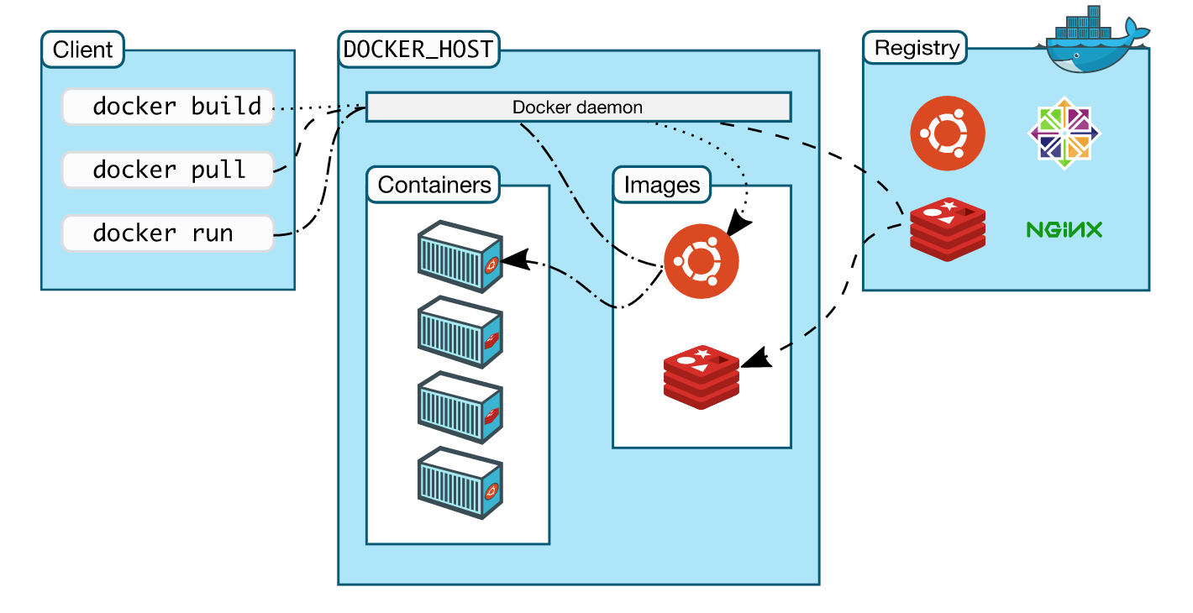
How is Docker Architected?
Notes:
Docker uses a client-server architecture. The Docker client talks to the Docker daemon, which does the heavy lifting of building, running, and distributing your Docker containers. The Docker client and daemon can run on the same system, or you can connect a Docker client to a remote Docker daemon. The Docker client and daemon communicate via sockets or through a REST API.
Note: The Docker daemon runs with root privileges which introduces an attack opportunity. More behind this: https://docs.docker.com/engine/security/security/

Slide 13
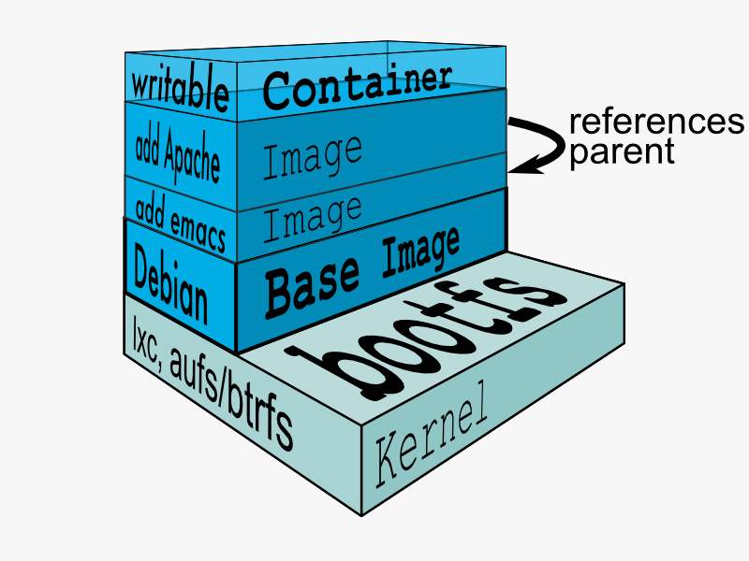
Docker Union File System
AuFS (AnotherUnionFS) is a multi-layered filesystem that implements union mount
allows several filesystems or directories to be simultaneously mounted and visible through a single mount point
appears to be one filesystem to the end user
Notes:
Union file systems, or UnionFS, are file systems that operate by creating layers, making them very lightweight and fast. Docker Engine uses UnionFS to provide the building blocks for containers. Docker Engine can use multiple UnionFS variants, including AUFS (the default for Ubuntu), btrfs, vfs, and DeviceMapper (the default for Red Hat and Centos.
How AuFS Works
1.Mount a base image as read-only
2.Add read-write file system over read-only file system
3.Change some files and directories to top as read- write file system
4.It is committed
5.Save incremental files and directories in new image
6.Mount the image as read-only and add read-write file system on top

Slide 14
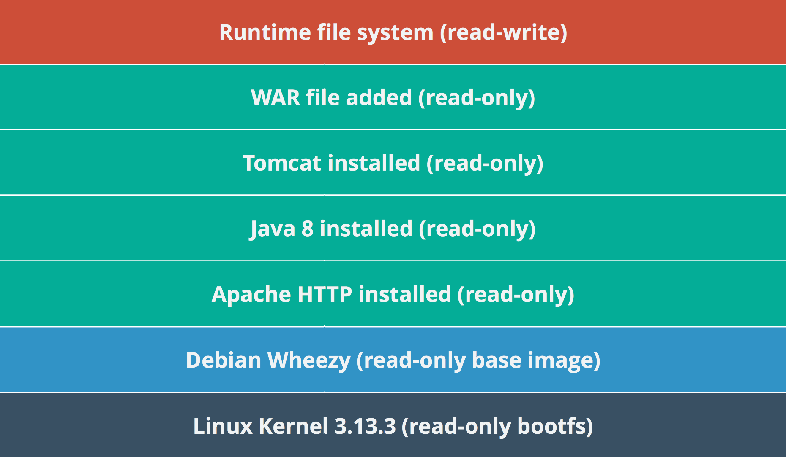
Example Docker Layers
Docker Layer – Each Docker image is composed of a series of layers. Docker uses Union File Systems to combine these into a single image. The combination of these layers gives the illusion of a traditional file system. Only the top layer is writeable.

Slide 15
Where Containers are used?
DevOps (Mostly in all types of Automation)
Automated testing (Unit, acceptance and stress testing)
CICD (if not tested on production-like environment, CICD will be risky)
Microservices
Less risky deployment architectures
Chef kitchen test
Not only used for testing but is used in production (along with container orchestration) in B2C and B2B organizations

Slide 16
Advantage of using Containers
Developers testing their code in Prod environments
Lesser hand-offs and drastically lesser waiting time (to get new environment setup)
Reduce technical debt
Overall system resilience - Service failure does not kill the application & may be invisible to users
Scalability
Seamless replication
High Availability
Less risky patterns for rolling updates available
Prevent server sprawl and Jenga infrastructure

Slide 17
Introduction to Kubernetes
Part 1:

Slide 18
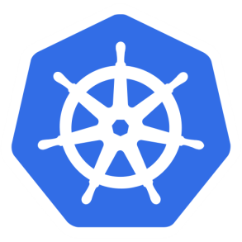
Kubernetes
The name Kubernetes is Greek
Translates to “helmsman” or “pilot”
Root of ”Governor” and “Cybernetic”
“K8s” is a shorthand abbreviation derived by replacing the 8 letters “ubernete” with 8.
Notes:
Trivia:
The founders initially wanted to call it “seven of nine” in reference to the nice, friendlier borg from Star Trek. This name did not survive, but for this reason the Kubernetes logo has seven sides
Reference:
https://cloudplatform.googleblog.com/2016/07/from-Google-to-the-world-the-Kubernetes-origin-story.html

Slide 19

Cloud Native Computing Foundation (CNCF)
Mission of the Cloud Native Computing Foundation.
“The Foundation’s mission is to create and drive the adoption of a new computing paradigm that is optimized for modern distributed systems environments capable of scaling to tens of thousands of self healing multi-tenant nodes.”
Formed in Nov 6, 2015 with Kubernetes as its first project
The CNCF is building an ecosystem of complementary projects including Prometheus, Fluentd, Linkerd, Rkt, and others
Notes:
https://www.cncf.io/about/charter/
1. Mission of the Cloud Native Computing Foundation. The Foundation’s mission is to create and drive the adoption of a new computing paradigm that is optimized for modern distributed systems environments capable of scaling to tens of thousands of self healing multi-tenant nodes.
Cloud native systems will have the following properties:
(a) Container packaged. Running applications and processes in software containers as an isolated unit of application deployment, and as a mechanism to achieve high levels of resource isolation. Improves overall developer experience, fosters code and component reuse and simplify operations for cloud native applications.
(b) Dynamically managed. Actively scheduled and actively managed by a central orchestrating process. Radically improve machine efficiency and resource utilization while reducing the cost associated with maintenance and operations.
(c) Micro-services oriented. Loosely coupled with dependencies explicitly described (e.g. through service endpoints). Significantly increase the overall agility and maintainability of applications. The foundation will shape the evolution of the technology to advance the state of the art for application management, and to make the technology ubiquitous and easily available through reliable interfaces.

Slide 20
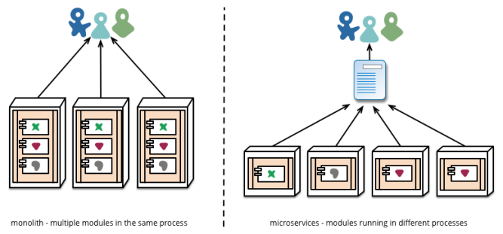
What is a Microservice?
A service that can be independently deployed
Notes:
https://martinfowler.com/articles/microservices.html

Slide 21
Microservice: advantages
Simple services that are focused on doing one thing well
Each service can be built using the best tool for the job
Systems built this way are inherently loosely coupled
Teams can deliver and deploy independently from each other
Enable continuous delivery but allowing frequent releases while the rest of the system continues to be stable
Notes:
Can be (but not always)
< 6000 lines
https://martinfowler.com/articles/microservices.html

Slide 22
Kubernetes Setup
Kubernetes can be setup on multiple clouds
Google(GCP) & Microsoft offer Kubernetes as a service, with reliable experiences
AWS has two great open source methods, ’Kops’ and Heptio’s Cloud Formation Script
Last year AWS added Kubernetes as a Service
Kubernetes can readily be setup locally, with ‘Minikube’ or ‘kubeadm’
Notes:
http://gist-reveal.it/bit.ly/ato-k8s#/presented-by-ryanj

Slide 23
Kubernetes Setup (AWS) - Kubeadm
We will use AWS for this class
Each student will log on to a AWS EC2 machine
1 node will be used as a master and client
We will use set up instructions on github
We will see a demo to use 2 nodes and treat them as a cluster.
Notes:
http://gist-reveal.it/bit.ly/ato-k8s#/presented-by-ryanj

Slide 24
Local Kubernetes
Use the instructions to run the 4 instructions
-- will set up master
-- enable networking, untaint the master node
-- should be able to run commands
https://github.com/abhikbanerjee/Kubernetes_Exercise_Files/blob/master/AWS_setup_files/Kubernetes_Setup_AWS.md
Notes:
https://github.com/abhikbanerjee/Kubernetes_Exercise_Files/blob/master/AWS_setup_files/Kubernetes_Setup_AWS.md

Slide 25
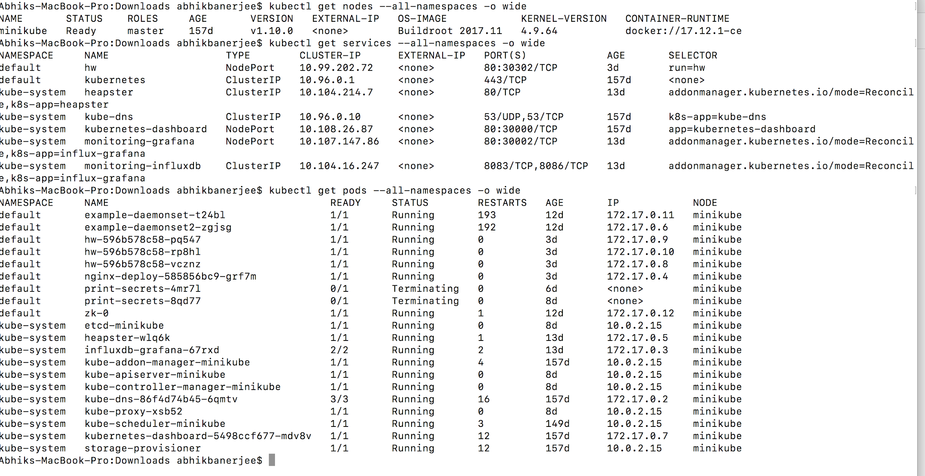
Example Commands
kubectl get nodes --all-namespaces -o wide
kubectl get services --all-namespaces -o wide
kubectl get pods --all-namespaces -o wide
kubectl get deployment --all-namespaces -o wide
Notes:
https://github.com/abhikbanerjee/Kubernetes_Exercise_Files/blob/master/AWS_setup_files/Kubernetes_Setup_AWS.md

Slide 26

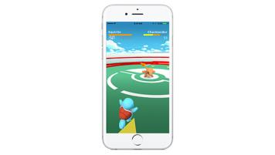

Pokemon Go

Slide 27
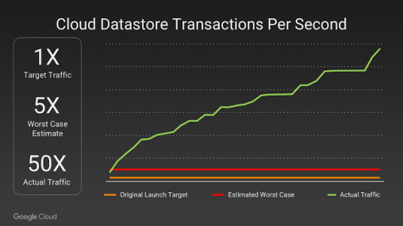
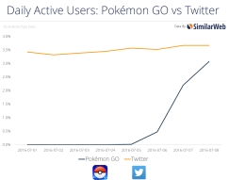
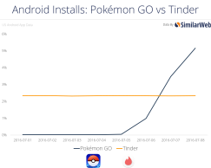
Pokemon Go: Situation
Pokemon Go launched a hit app! The application was a viral, overnight roaring success.
The challenge? It rapidly had 50x the worst case traffic estimate and grew rapidly
Achieved the same active users in a month that took Twitter years to reach
Was the most downloaded app in history within a few days
Notes:
Y Axis – Traffic to Cloud Datastore
X Axis - Date

Slide 28
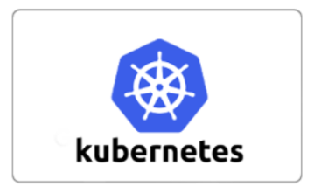

Pokemon Go: Action
Application for the logic ran on Google Container Engine powered by Kubernetes.
Enabled automation to scale the application to millions of users
Also enabled upgrading the version of the cluster and load balancer without downtime while millions of players were online

Slide 29


Pokemon Go: Action
Even Google doesn’t have unlimited resources and engineers
Google CRE (Cloud Reliability Engineer team) worked closely with Niantic to review and optimize the architecture.
Pokemon Go used Cloud Datastore, a cloud native NoSQL database.
This enabled the application to scale without the sharding requirements that would have been needed with MySQL or Postgres for example

Slide 30
Pokemon Go: Result
Was able to launch in Japan a mere two weeks after the US launch, where they received 3x the US users without incident.
Was the largest Kubernetes deployment ever, with multitude of bugs identified, fixed and merged into the open source repo
The cluster ended up utilizing tens of thousands of cores
Arguably the first successful overnight/viral planet-wide launch
Was eventually downloaded more than 500 million times and 25 million players at peak
Inspired users to walk over 5.4 billion miles over the course of a year due to gameplay
Notes:
https://news.ycombinator.com/item?id=12606995
https://cloudplatform.googleblog.com/2016/09/bringing-Pokemon-GO-to-life-on-Google-Cloud.html
http://www.theserverside.com/feature/How-Pokemon-Go-created-a-Kuburnetes-powered-Java-cloud
https://uploadvr.com/google-pokemon-go-server-issues-unavoidable/

Slide 31
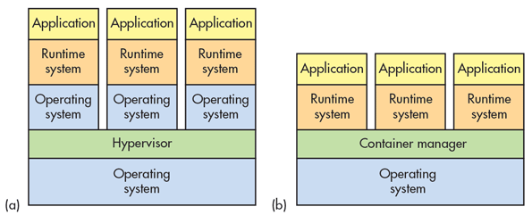
Container Advantages
Portable
Isolated
Lighter footprint & overhead (vs VMs)
Simplify Devops practices
Speed up Continuous Integration
Empower Microservice architectures and adoption

Slide 32
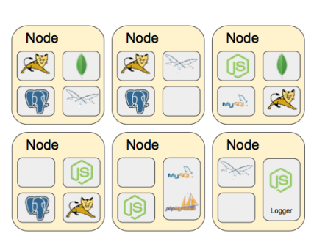
Challenges with multiple containers
How to scale?
Once I scale, where are they?
How do my containers find each other?
How should I manage port conflicts?
What if a host fails?
How to update them? Health checks?
How will I track their logs?

Slide 33
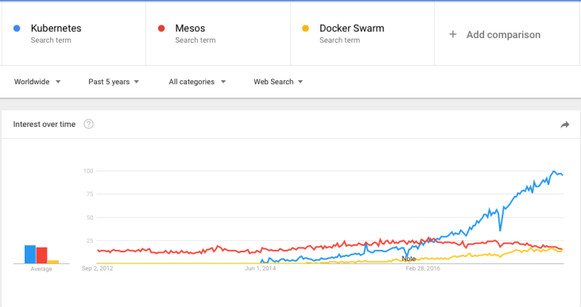
Container Orchestration Tools
The three most popular are: Kubernetes, Docker Swarm & Mesos
Kubernetes has become the unofficial standard
Notes:
Google started creation of its own open source orchestration tool ‘Kubernetes’. It has slowly gained dominance as the standard container orchestration tool except for niche use cases.
Mesos
Still used in early container adoption shops and big data applications
Docker Swarm
Lightweight and may be useful for rapid prototyping. With the ease of deploying Kubernetes to public cloud and greater feature set of Kubernetes this use case is increasingly shrinking.

Slide 34
Orchestration Tool Functions
Provision Hosts
Instantiate Containers on Hosts
Restart Failing Containers
Expose Containers as service outside the cluster
Scale the cluster up or down

Slide 35
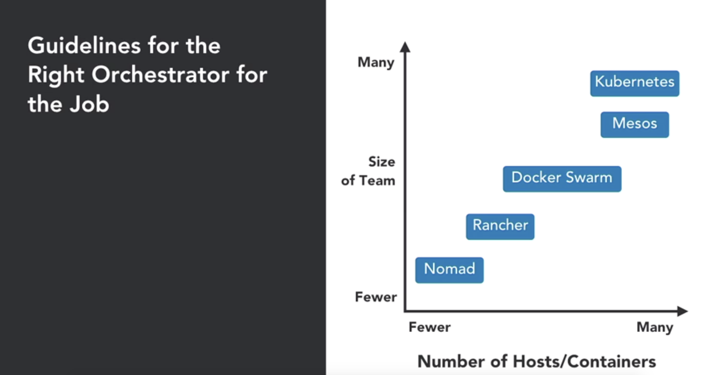
Guidelines for right infra
Ref:- https://www.linkedin.com/learning/learning-kubernetes/next-steps
Notes:
This is a rapidly changing patch work. This snapshot is of 03/2016. (https://blog.octo.com/docker-en-production-la-bataille-sanglante-des-orchestrateurs-de-conteneurs/)
Since then Kubernetes has an improved WebUI, Autoscaling and Multi-tenancy features among others. It’s a fast moving space!

Slide 36
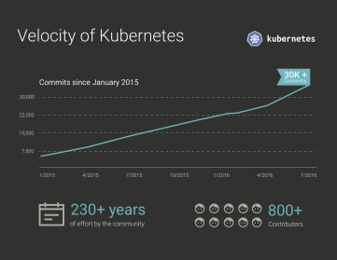
Kubernetes Stats
Top 100 project by stars
22k LinkedIn professionals
Largest container management ecosystem
Github
54k+ Commits | 280+ Releases | 1365+ Contributors
Top 100 Forked Github Project | Top 2 Starred Go Project | Top 0.01% Starred Github Project

Slide 37
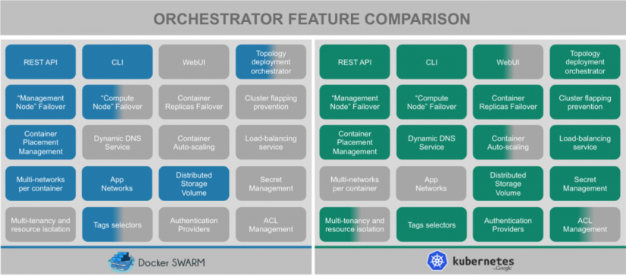
Feature Comparison (March 2016)
Notes:
This is a rapidly changing patch work. This snapshot is of 03/2016. (https://blog.octo.com/docker-en-production-la-bataille-sanglante-des-orchestrateurs-de-conteneurs/)
Since then Kubernetes has an improved WebUI, Autoscaling and Multi-tenancy features among others. It’s a fast moving space!

Slide 38
What is Kubernetes?
Kubernetes is inspired from an internal Google project called Borg
Open source project managed by the Linux Foundation
Unified API for deploying web applications, batch jobs, and databases
Decouples applications from machines through containers
Declarative approach to deploying applications
Automates application configuration through service discovery
Maintains and tracks the global view of the cluster
APIs for deployment workflows
Rolling updates, canary deploys, and blue-green deployments
Notes:
Unified API – Rest API to call various applications.
Decouple – Works on abstraction or logical pool of infrastructure, and apps are not tied directly to machines
Declarative approach – define/declare the entire requirement or specs in JSON or Yaml files and submit to Kubernetes. An example:- I need a stateful application, that use SSD back-end; better I/O; 20 instances to be run anywhere in cluster; expose set of containers following under this group and expose these ports, etc.
Service discovery – Earlier, when apps are hosted in physical drives, the network protocols used to be static. Now, we use containers and we need massive scaling and autoscaling, here network protocols like IP/ports are dynamic, service discovery is used to manage

Slide 39
Why Kubernetes?
Kubernetes is an open-source system for automating deployment, scaling, and management of containerized applications.
Co-locating helper processes, facilitating composite applications and preserving the one-application-per-container model
Mounting storage systems
Distributing secrets
Checking application health
Replicating application instances
Using Horizontal Pod Autoscaling
Balancing loads
Rolling updates
Monitoring resources
Debugging applications
Providing authentication and authorization
Notes:
What does Kubernetes mean? K8s? Pronounced ”Kates”
The name Kubernetes originates from Greek, meaning helmsman or pilot, and is the root of governor and cybernetic. K8s is an abbreviation derived by replacing the 8 letters “ubernete” with “8”

Slide 40
What is Kubernetes?
Use Kubernetes API object to describe cluster’s desired state
Next the Kubernetes Control Plane works to make the desired state same to the current state
Kube master is a collection of Kube-apiserver, kube-controller, and kube-scheduler
Kubernetes Node consists of kubelet, kube-proxy, and container management
Basic Kubernetes Objects (Pods, Services, Volumes, Namespaces)
Higher Level abstractions (ReplicsaSets, StatefulSets, DaemonSets, Deployments, Jobs)
Notes:
you use Kubernetes API objects to describe your cluster’s desired state: what applications or other workloads you want to run, what container images they use, the number of replicas, what network and disk resources you want to make available, and more. You set your desired state by creating objects using the Kubernetes API, typically via the command-line interface, kubectl. You can also use the Kubernetes API directly to interact with the cluster and set or modify your desired state.
Once you’ve set your desired state, the Kubernetes Control Plane works to make the cluster’s current state match the desired state. To do so, Kubernetes performs a variety of tasks automatically–such as starting or restarting containers, scaling the number of replicas of a given application, and more. The Kubernetes Control Plane consists of a collection of processes running on your cluster:
The Kubernetes Master is a collection of three processes that run on a single node in your cluster, which is designated as the master node. Those processes are: kube-apiserver, kube-controller-manager and kube-scheduler.
Each individual non-master node in your cluster runs two processes:
kubelet, which communicates with the Kubernetes Master.
kube-proxy, a network proxy which reflects Kubernetes networking services on each node.
The basic Kubernetes objects include:
Pod
Service
Volume
Namespace
In addition, Kubernetes contains a number of higher-level abstractions called Controllers. Controllers build upon the basic objects, and provide additional functionality and convenience features. They include:
ReplicaSet
Deployment
StatefulSet
DaemonSet
Job

Slide 41
Kubernetes Architecture
Yaml/Json
config file
Kubernetes Master
API
Node 1
Node 2
UI
Node 3
CLI
Node n
Registry
Notes:
Kubernetes is a distributed system, it has a master that maintains the global view and has access to set of nodes that runs the workloads.
API, UI (has dashboard) or CLI (kubectl) are used to submit the workload or interact with the master. They submit using Yaml or Json (config) file. The role of the master is to understand the definition of Yaml, figure out constraints/policies/requirements, cores/memory requirements, any specific node or type of hardware like ssd, if required, and finally throws the container to schedule the environments. All these are pushed to nodes.
The job of a node is to pull appropriate container images from private/public registry and translates the entire spec into deployment.

Slide 42
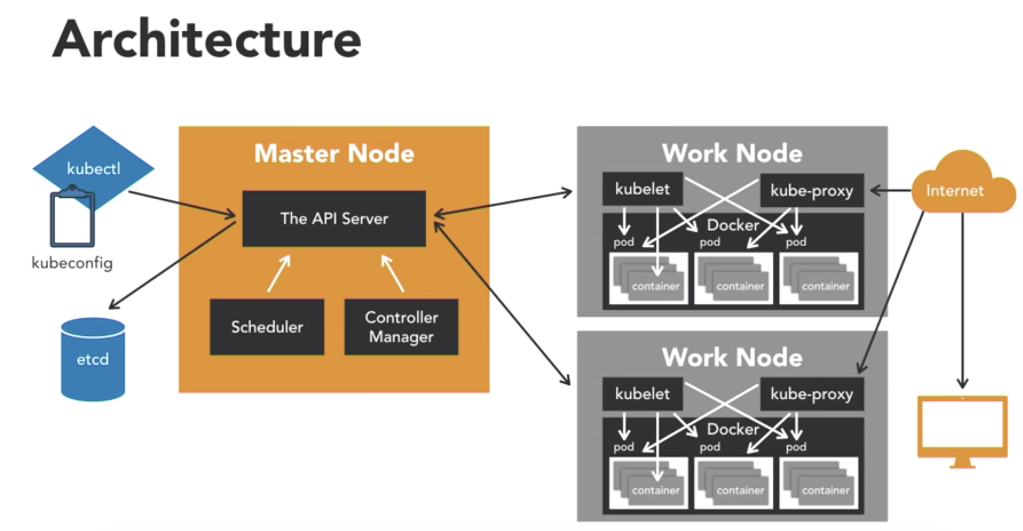
K8s Architecture - detailed
Ref:- https://www.linkedin.com/learning/learning-kubernetes/next-steps

Slide 43
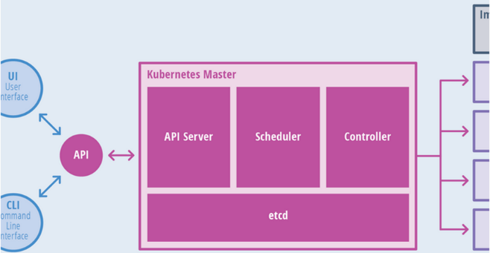
Kubernetes Master
Components of master:
API Server
Scheduler
Controller
etcd

Slide 44
Kubernetes Master
The API server is the entry points for all the REST commands used to control the cluster. It processes REST requests, validates them, and executes the bound business logic. The result state has to be persisted in the “etcd” component.
Etcd is an open source, distributed key-value database; it acts as a single source of truth (SSOT) for all components of the Kubernetes cluster. Masters query etcd to retrieve various parameters of the state of the nodes, pods and containers. Etcd is considered a metadata service in Kubernetes.

Slide 45
Kubernetes Master
Controller Manager is responsible for most of the collectors that regulate the state of the cluster. In general, a controller can be considered a daemon that runs in non terminating loop and is responsible for collecting and sending information to the API server. It works toward getting the shared state of cluster and then making changes to bring the current status of the server to the desired state. The key controllers are replication controller, endpoint controller, node controller, and service account & token controller. The controller manager runs different kind of controllers to handle nodes, endpoints, etc.
Scheduler is one of the key components of Kubernetes master. It is responsible for distributing the workload, tracking resource utilization on cluster nodes and selecting the nodes for the workloads to run. In other words, this is the mechanism responsible for allocating pods to available nodes.
Notes:
controller performs a series of tasks - node controller (responsible for the worker states), replication controller (maintain fixed number of pods), end-point controller ( which joins services and pods together), service account and token controllers (that manage access controls)

Slide 46
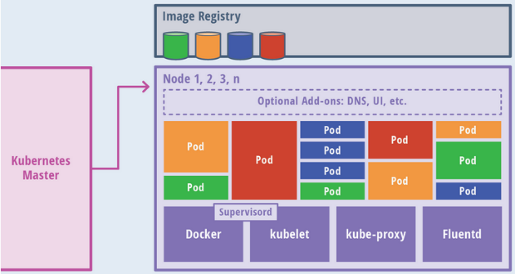
Kubernetes Nodes
Components of a node:
kubelet
Kube-proxy
Docker
Fluentd

Slide 47
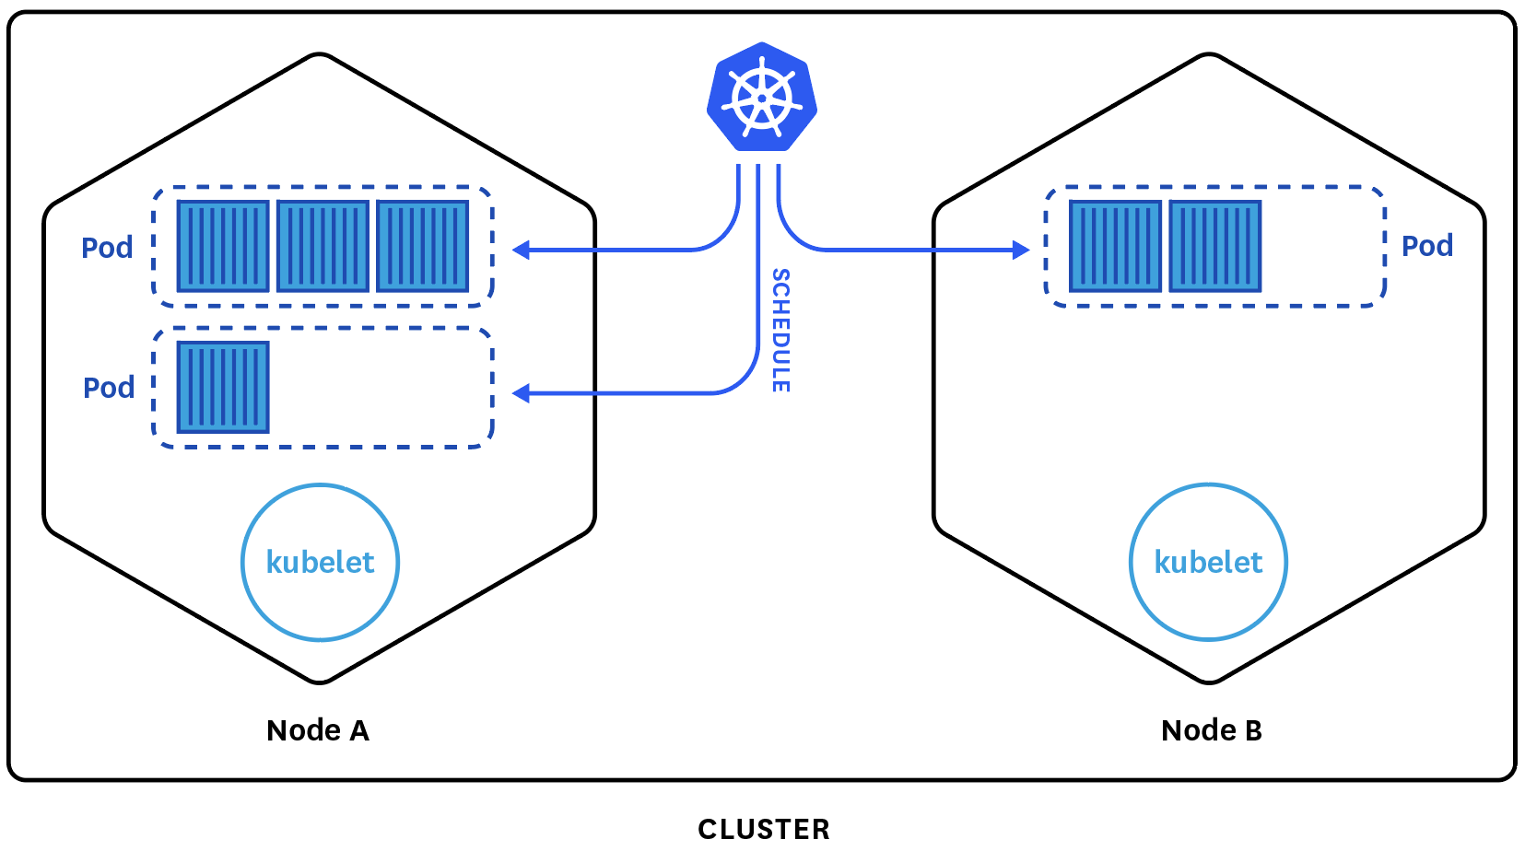
Kubernetes: Nodes
A node is a worker machine in Kubernetes. A node may be a VM or physical machine, depending on the cluster. Each node has the services necessary to run pods and is managed by the master components. The services on a node include Docker, kubelet and kube-proxy. See The Kubernetes Node section in the architecture design doc for more details.

Slide 48
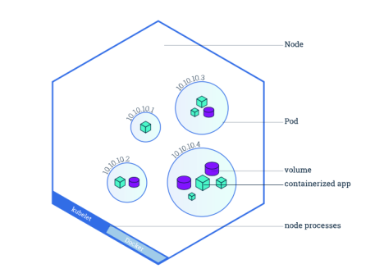
Kubernetes: Nodes
Allows Pods to be scheduled. A basic worker physical or virtual machine of Kubernetes.
Must be managed by a master
May host multiple pods
Internal IP Address endpoint
Can be tagged and filtered using labels
Runs 3 processes - Kubelet, Kube Proxy and Container Runtime

Slide 49
Kubernetes: Nodes
Node Status
A node status contains:
Addresses
Hostname
ExternalIP
InternalIP
Condition - describe condition of nodes.
Capacity - describe the resources available on the node
Info - general information about the node

Slide 50
$ kubectl get nodes
Note: Affinity & Anti-affinity (Beta) allow further constraints on where a pod may run (coupled, de-coupled, only nodes with certain labels, etc)
Notes:
Kubectl get nodes
As long as you have a working cluster and connection to the cluster this command should work. This is usually one of the first commands you call to ensure the cluster is alive.
http://kubernetesbyexample.com/nodes/

Slide 51
Kubernetes Node - Kubelet
Kubelet Service on each node is responsible for relaying information to and from the control plane service. It interacts with etcd store to read configuration details and to write values via api-server. It communicates with the master component to receive commands and work. The kubelet process then assumes responsibility for maintaining the state of work and the node server. It manages network rules, port forwarding, etc.
Notes:
-- kubelet process runs on the worker node, to make sure pods have been assigned.

Slide 52
Kubernetes Node - Kube Proxy
Kubernetes Proxy Service is a proxy service which runs on each node and helps in making services available to the external host. It helps in forwarding the request to correct containers and is capable of performing primitive load balancing. It makes sure that the networking environment is predictable and accessible and at the same time it is isolated as well. It manages pods on node, volumes, secrets, creating new containers’ health checkup, etc.
Notes:
-- kube proxy is the load balancer and network proxy for the service on the worker node, for TCP and UDP packets

Slide 53
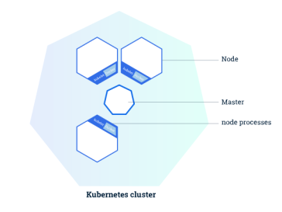
Kubernetes: Clusters
Allows you to deploy containerized applications to a cluster without tying them specifically to individual machines.
Masters
Coordinates the cluster
Schedules applications
Maintains application state
Scales applications
Rolls out updates
Can be duplicated when HA (High Availability) is desired.
Often run as a service by public cloud providers (Azure/Google Kubernetes as a Service)

Slide 54
Addons
DNS - While the other addons are not strictly required, all Kubernetes clusters should have cluster DNS, as many examples rely on it.
Web UI (Dashboard) - Dashboard is a general purpose, web-based UI for Kubernetes clusters.
Container Resource Monitoring - Container Resource Monitoring records generic time-series metrics about containers in a central database, and provides a UI for browsing that data.
Cluster-level Logging - A Cluster-level logging mechanism is responsible for saving container logs to a central log store with search/browsing interface.

Slide 55
Kubernetes Terms
Containers
Nodes
Clusters
Pods (Object)
Deployment (Controllers)
ReplicaSets (Controllers)
Services (Object)
Labels
Volumes (Object)
Namespaces (Object)
StatefulSet (Controllers)
DaemonSet (Controllers)
Job (Controllers)
Notes:
Ref - https://cloudplatform.googleblog.com/2018/04/Kubernetes-best-practices-Organizing-with-Namespaces.html

Slide 56
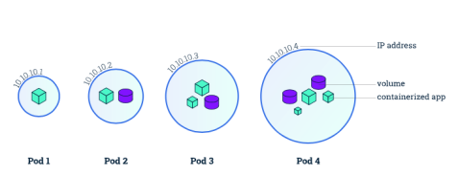
Kubernetes: Pods
The smallest unit that can be scheduled to be deployed through K8s is called a pod.
Homogeneous group of containers.
This group of containers would share storage, Linux namespaces, cgroups, IP addresses. These are co-located, hence share resources and are always scheduled together.
Pods are not intended to live long. They are created, destroyed and re-created on demand, based on the state of the server and the service itself.
Containers in a pod share
IP address and port space
Filesystem
Storage (Volumnes)
Labels
Secrets
Notes:
Additionally, pods can be tagged with a label for recommended scheduling advice

Slide 57
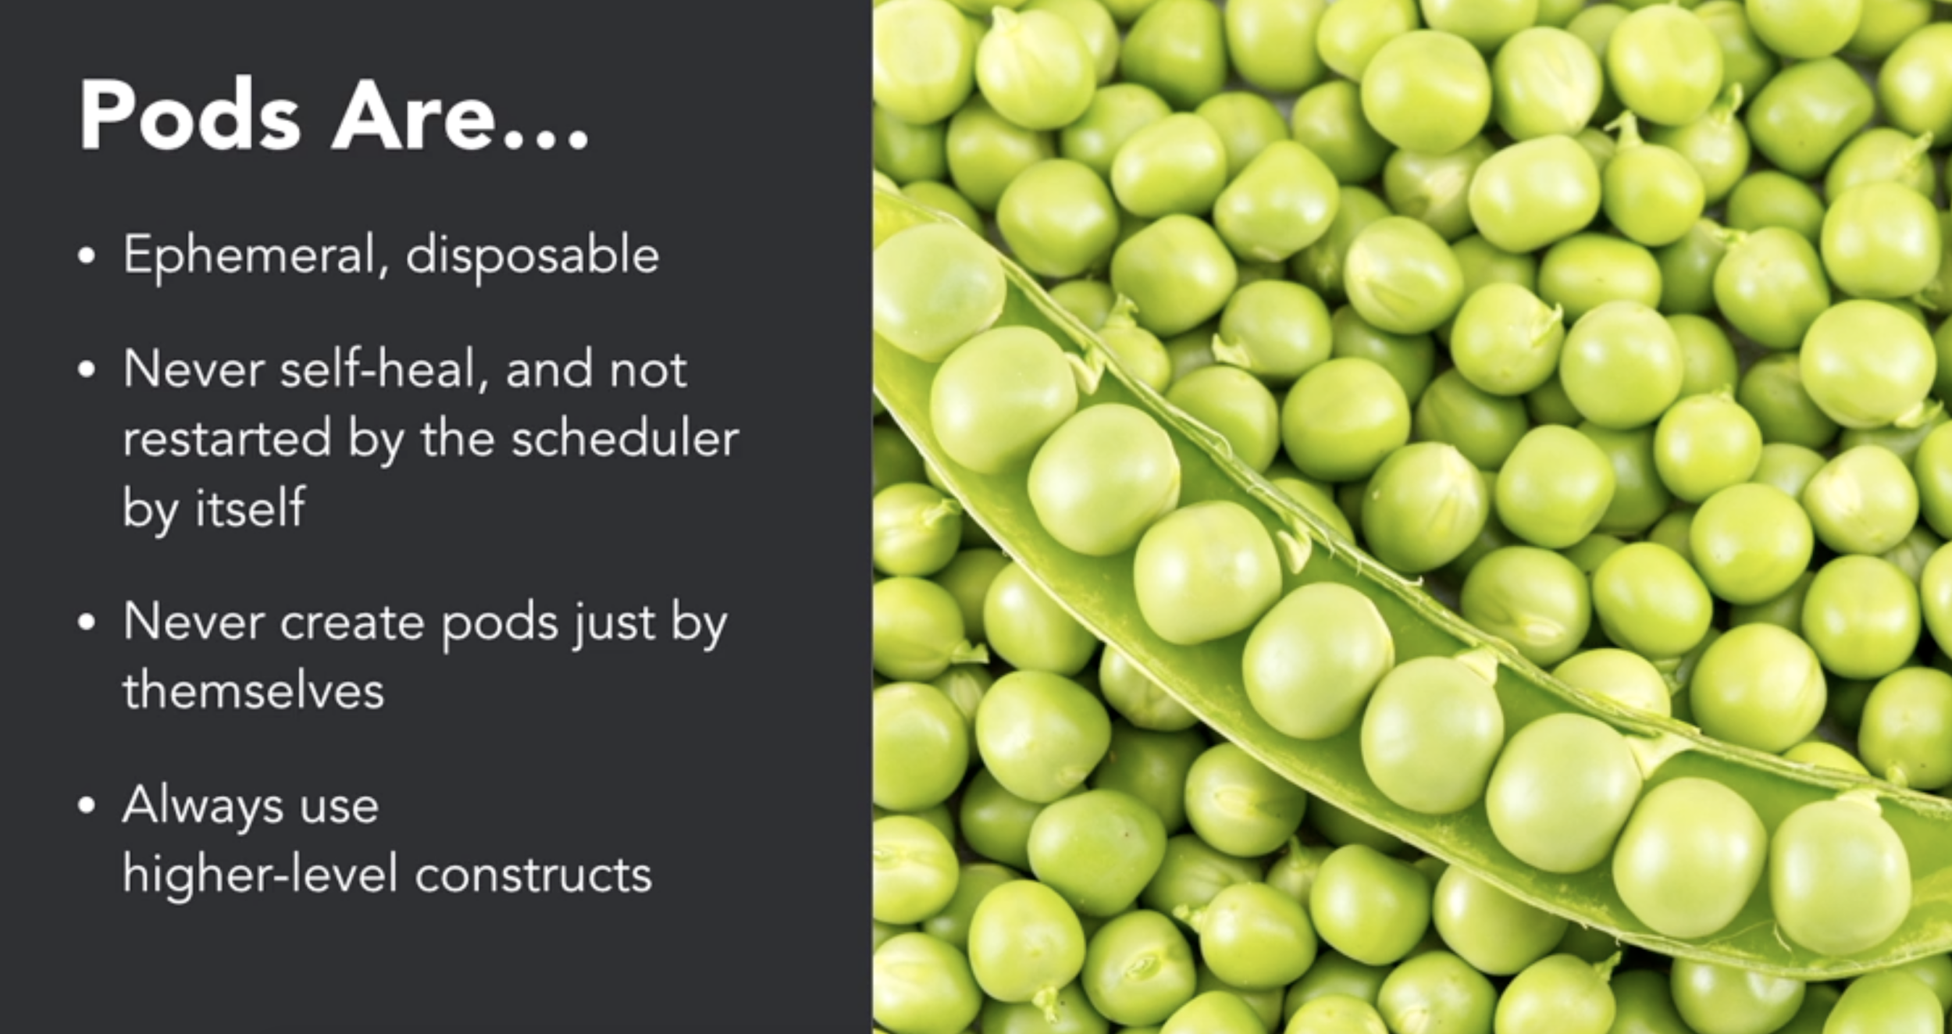
Kubernetes: Pods
Ref:- https://www.linkedin.com/learning/learning-kubernetes/next-steps
Notes:
Additionally, pods can be tagged with a label for recommended scheduling advice

Slide 58
Kubernetes: Pod States
Pod States
Pending (request accepted, one or more containers are still being created)
Running (Pod has been bound to a node, all of the Containers have been created. At least one Container is still running, or is in the process of starting or restarting.)
Succeeded (All Containers in the Pod have terminated in success, and will not be restarted)
Failed (All Containers in the Pod have terminated, and at least one container has terminated with some failure)
CrashLoopBackOff (pod starting, crashing, starting again, and then crashing again.)
Notes:
Additionally, pods can be tagged with a label for recommended scheduling advice

Slide 59
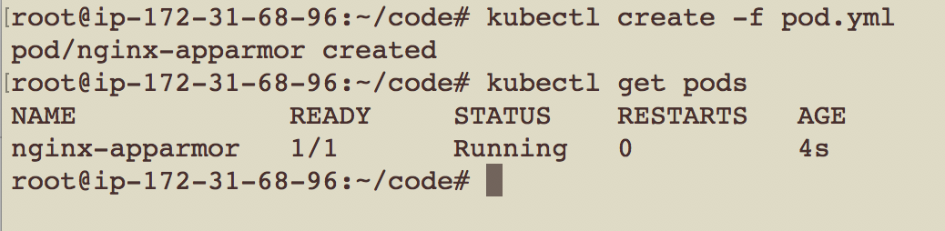
pod.yml
apiVersion: v1
kind: Pod
metadata:
name: nginx-apparmor
labels:
app: nginx
spec:
containers:
- name: nginx
image: nginx
ports:
- containerPort: 80
Note: This is just creation of the pod. In order to expose it, a service must be created. In order for it to be respawned, a deployment or replication control must be created.
Notes:
Create a simple pod.yaml with the following contents
apiVersion: v1
kind: Pod
metadata:
name: nginx
labels:
name: nginx
spec:
containers:
- name: nginx
image: nginx
ports:
- containerPort: 80
2. Kubectl create –f pod.yaml
3. Kubectl get pods
This highlights an example of Kubernetes deployment creation. As with many Kubernetes objects, deployments are usually created from a file such as a yaml or json. While this could be done via command line it is often impractical to do so.
Further reading:
https://kubernetes.io/docs/concepts/workloads/controllers/deployment/#creating-a-deployment

Slide 60
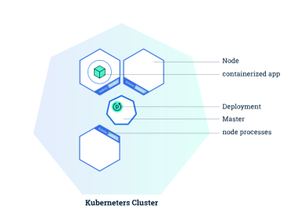
Kubernetes: Deployments
Allows you to deploy a (self-healing) instance of an application.
Self Healing: Continuously monitors and replaces instances if necessary
Provides declarative updates for Pods and Replica Sets
Updates actual state to desired state at a controlled rate
For example: Current state, 3 instances of Tomcat. Desired state, 5 instances of Tomcat. -> Create 2 more instances of Tomcat
Notes:
Deployments (and controllers) are loops that maintain state.

Slide 61
Kubernetes: Deployment
Abstraction that use Replication controller (Controller manager of kubernetes master) to manage replicas of pods (replaced by replica-sets and deployments)
If object {pod} is used, and it dies, it will not start again
If object {deployment} is used to start pods, if the pod dies, deployment use replica-set to start the pods again to make sure desired number of pods are always alive
Try deleting a pod (deployed using deployment) and check if it comes back?

Slide 62
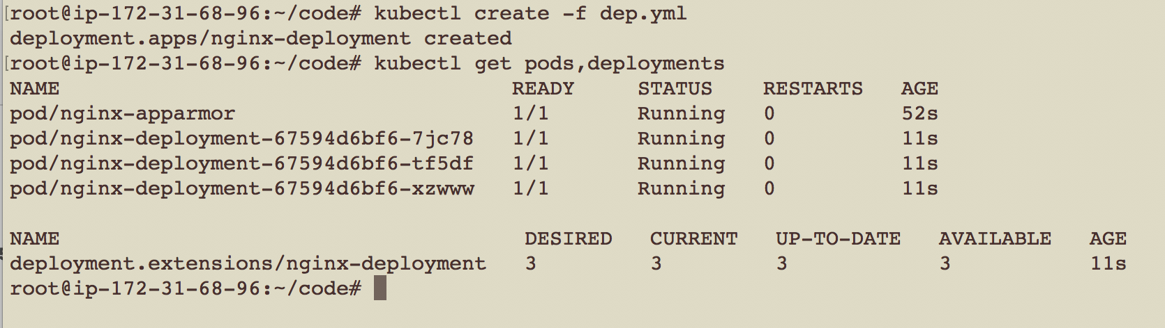
dep.yml
apiVersion: apps/v1
kind: Deployment
metadata:
name: nginx-deployment
labels:
app: nginx
spec:
replicas: 3
selector:
matchLabels:
app: nginx
template:
metadata:
labels:
app: nginx
spec:
containers:
- name: nginx
image: nginx:1.7.9
ports:
- containerPort: 80

Slide 63
$ kubectl create / apply
kubectl create -f <yaml_file>
kubectl create -f <yaml_file_1> -f <yaml_file_2>
kubectl create -f <json_file>
kubectl create -f <url_name>
kubectl create -f <directory_name>
kubectl create -f <yaml_file> (ok when multiple teams are not working on the same config files)
kubectl apply -f <json_file> (practically used in teams where multiple teams / members want to maintain versions)
$ kubectl create -f blue.yaml
$ kubectl create -f green.yaml -f red.yaml
$ kubectl create -f pink.yaml ,
$ kubectl edit -f pink.yaml
$ kubectl create -f colors/
Ref:- https://www.linkedin.com/learning/learning-kubernetes/next-steps
Notes:
Create a pod.yaml with the following contents
apiVersion: v1
kind: Pod
metadata:
name: nginx
labels:
name: nginx
spec:
containers:
- name: nginx
image: nginx
ports:
- containerPort: 80
2. Kubectl create –f pod.yaml
3. Kubectl get pods
This highlights an example of Kubernetes deployment creation. As with many Kubernetes objects, deployments are usually created from a file such as a yaml or json. While this could be done via command line it is often impractical to do so.
Further reading:
https://kubernetes.io/docs/concepts/workloads/controllers/deployment/#creating-a-deployment
Note: This is a simple pod. This is interesting.

Slide 64
Kubernetes: RS, RC and Deployment
Replication Controllers - A Replication Controller is a structure that enables you to easily create multiple pods, then make sure that that number of pods always exists. If a pod does crash, the Replication Controller replaces it. The major difference is that the rolling-update command works with Replication Controllers, but won’t work with a Replica Set. This is because Replica Sets are meant to be used as the backend for Deployments
A Replica Set Replica Sets are declared in essentially the same way as Replication Controllers, except that they have more options for the selector.
Deployments - We have seen this before, uses replication sets , and also provide rolling updates.
Ref:- https://www.mirantis.com/blog/kubernetes-replication-controller-replica-set-and-deployments-understanding-replication-options/

Slide 65
Exercise - 1
Exercise to create Replication Controllers, Replica Sets and Deployments and describe their functions.
Check the results and describe the objects
https://github.com/abhikbanerjee/Kubernetes_Exercise_Files/blob/master/AWS_rc_rs_deploy.md
Ref:- https://www.mirantis.com/blog/kubernetes-replication-controller-replica-set-and-deployments-understanding-replication-options/

Slide 66
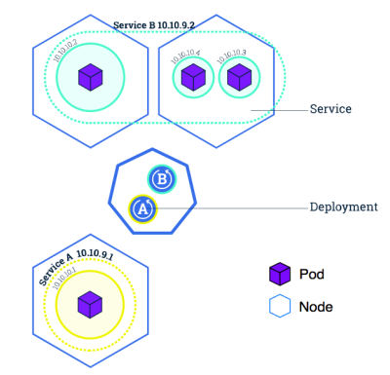
Kubernetes: Service
Abstraction regarding a set of pods which enables load balancing, traffic exposure, load balancing and service discovery.
pods to die and replicate in Kubernetes without affecting your application.
Enable loose coupling between different Pods.
Provides a stable virtual IP and port
Services allow Pods to receive traffic.
Each Pod has a unique IP but those IP addresses are not exposed outside the Pod without a service.

Slide 67
Kubernetes: Types of Services
Cluster IP:- Expose the service on a cluster-internal IP. Using this makes the service only reachable from within the cluster (no external access).
NodePort :- Expose the service on each Node’s IP at a static port. One service per port, only use ports 30000–32767, have to deal with port changes
Load Balancer :- Expose the service externally using load balancer. The Kubernetes service controller automates the creation of the external load balancer, health checks (if needed), firewall rules (if needed) and retrieves the external IP allocated by the cloud provider and populates it in the service object
Notes:
When the service type is set to LoadBalancer, Kubernetes provides functionality equivalent to type=<ClusterIP> to pods within the cluster and extends it by programming the (external to Kubernetes) load balancer with entries for the Kubernetes pods. The Kubernetes service controller automates the creation of the external load balancer, health checks (if needed), firewall rules (if needed) and retrieves the external IP allocated by the cloud provider and populates it in the service object.
https://medium.com/google-cloud/kubernetes-nodeport-vs-loadbalancer-vs-ingress-when-should-i-use-what-922f010849e0 and https://medium.com/google-cloud/kubernetes-from-load-balancer-to-pod-3f2399637b0c

Slide 68
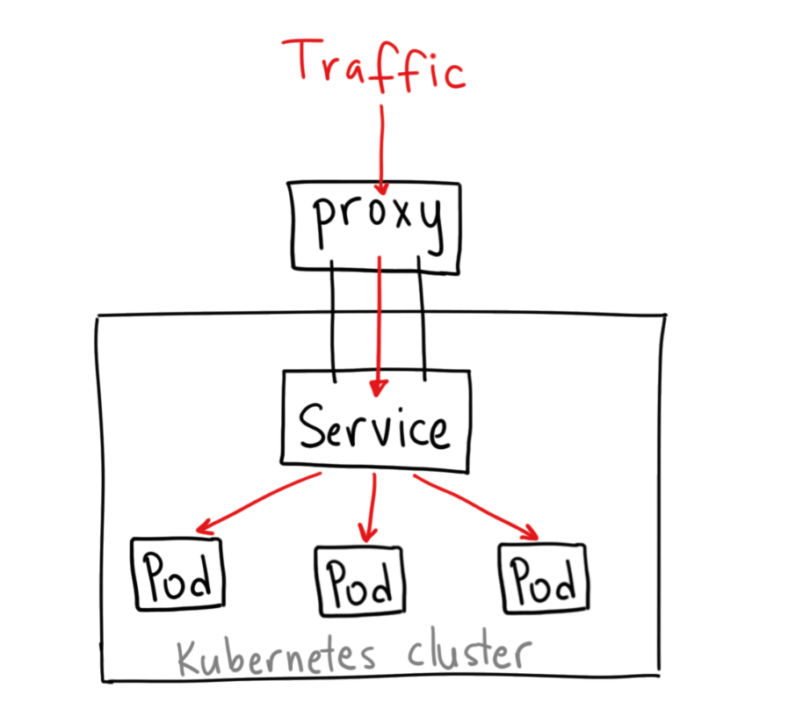
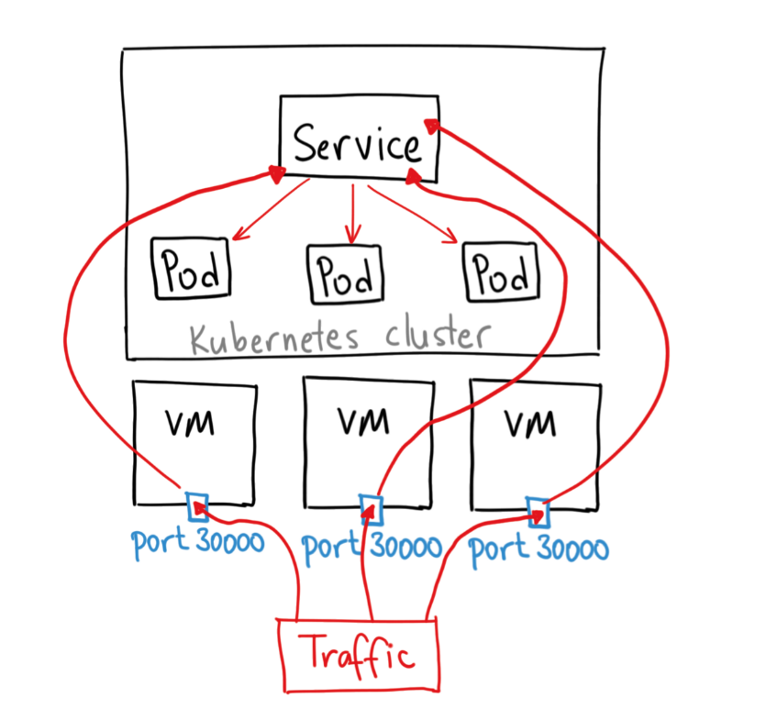
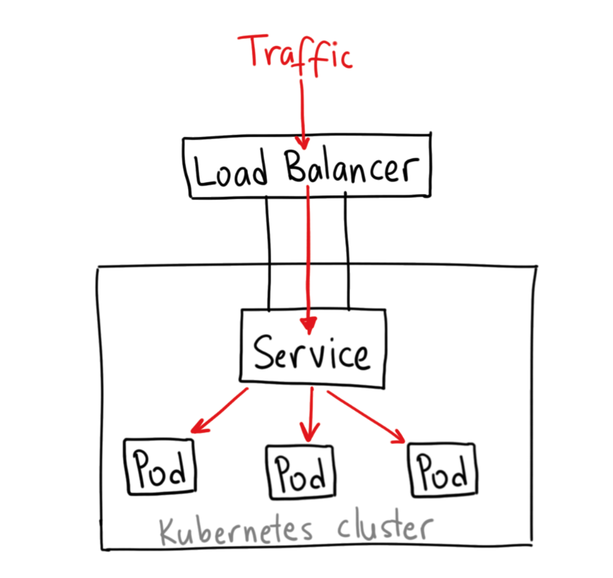
Kubernetes: Services
Cluster IP:- $ kubectl proxy --port=8080
NodePort :- check yaml config
Load Balancer :- check yaml config
Ref:- https://medium.com/google-cloud/kubernetes-nodeport-vs-loadbalancer-vs-ingress-when-should-i-use-what-922f010849e0
Notes:
A ClusterIP service is the default Kubernetes service. It gives you a service inside your cluster that other apps inside your cluster can access. There is no external access
A NodePort service is the most primitive way to get external traffic directly to your service. NodePort, as the name implies, opens a specific port on all the Nodes (the VMs), and any traffic that is sent to this port is forwarded to the service. - You can only have one service per port , You can only use ports 30000–32767, If your Node/VM IP address change, you need to deal with that
LoadBalancer - If you want to directly expose a service, this is the default method. All traffic on the port you specify will be forwarded to the service. There is no filtering, no routing, etc. This means you can send almost any kind of traffic to it, like HTTP, TCP, UDP, Websockets, gRPC, or whatever.The big downside is that each service you expose with a LoadBalancer will get its own IP address, and you have to pay for a LoadBalancer per exposed service, which can get expensive!

Slide 69
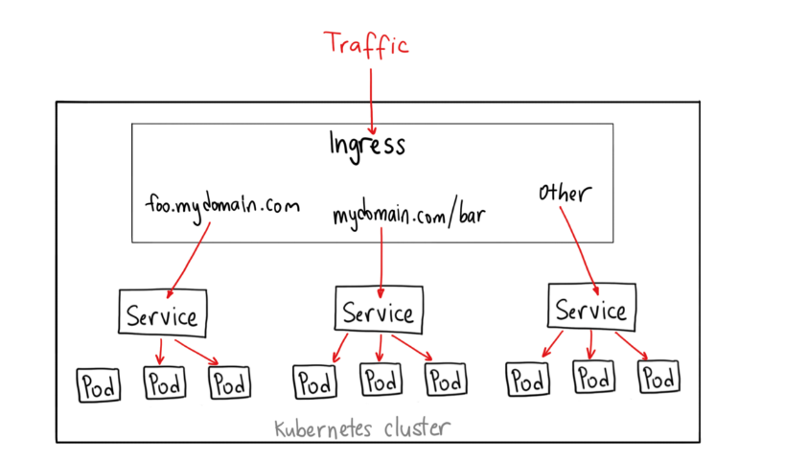
Kubernetes Ingress
Simplified Layer 7 access to Kubernetes services i.e. allows “internet” to reach services (not a type of service)
Works with load balancers, including the Google Cloud Load Balancer, Nginx, Contour, Istio, and more
expose multiple services under the same IP address
Ref:- https://medium.com/google-cloud/kubernetes-nodeport-vs-loadbalancer-vs-ingress-when-should-i-use-what-922f010849e0
Notes:
Instead, it sits in front of multiple services and act as a “smart router” or entrypoint into your cluster. You can do a lot of different things with an Ingress, and there are many types of Ingress controllers that have different capabilities.
This will let you do both path based and subdomain based routing to backend services. For example, you can send everything on foo.yourdomain.com to the foo service, and everything under the yourdomain.com/bar/ path to the bar service.
Ingress is the most useful if you want to expose multiple services under the same IP address, and these services all use the same L7 protocol (typically HTTP). You only pay for one load balancer if you are using the native GCP integration, and because Ingress is “smart” you can get a lot of features out of the box (like SSL, Auth, Routing, etc)

Slide 70
root@ip-172-31-68-96:~# kubectl get svc
NAME TYPE CLUSTER-IP EXTERNAL-IP PORT(S) AGE
kubernetes ClusterIP 10.96.0.1 <none> 443/TCP 37m
root@ip-172-31-68-96:~#
root@ip-172-31-68-96:~# kubectl expose deployment nginx-deployment --type=LoadBalancer --name=nginx-service
service/nginx-service exposed
root@ip-172-31-68-96:~#
root@ip-172-31-68-96:~# kubectl get svc
NAME TYPE CLUSTER-IP EXTERNAL-IP PORT(S) AGE
kubernetes ClusterIP 10.96.0.1 <none> 443/TCP 37m
nginx-service LoadBalancer 10.102.89.83 <pending> 80:31095/TCP 3s
root@ip-172-31-68-96:~#
Notes:
-- to make NodePort work - https://stackoverflow.com/questions/45543694/kubernetes-cluster-on-aws-with-kops-nodeport-service-unavailable/45561848#45561848 , show this in a 2 cluster node, using nodeport and exposing , only the inbound rule for that node - http://34.222.12.167:32083/
kubectl expose pod sharevol --type NodePort --name sharevol-service --port 3006
Example - create node , expose as nodePort service
kubectl expose pod nginx-apparmor --type NodePort --name nginx-apparmor-service --port 3003
-- to make NodePort work - https://stackoverflow.com/questions/45543694/kubernetes-cluster-on-aws-with-kops-nodeport-service-unavailable/45561848#45561848 , show this in a 2 cluster node, using nodeport and exposing , only the inbound rule for that node - http://34.222.12.167:32083/

Slide 71
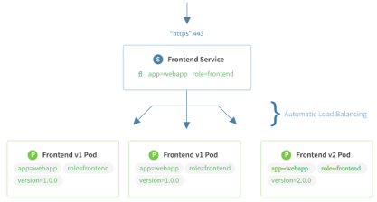
$ kubectl get services
Note: A component called ‘kube-proxy’ runs on each node and implements a form of virtual IP for services of type other than ‘ExternalName’
Notes:
kubectl get services --all-namespaces
This reveals the kubernetes services that are usually running as part of the kubernetes system namespace.
http://kubernetesbyexample.com/services/
As mentioned previously, a Service is backed by a group of Pods. These Pods are exposed through endpoints. The Service’s selector will be evaluated continuously and the results will be POSTed to an Endpoints object also named my-nginx. When a Pod dies, it is automatically removed from the endpoints, and new Pods matching the Service’s selector will automatically get added to the endpoints. Check the endpoints, and note that the IPs are the same as the Pods created in the first step:

Slide 72
$ kubectl Demo services
-- Create directly a deployment from CLI without the config file (Object management using Imperative Commands - e.g. run , expose, autoscale)
$ kubectl run nginx-deployment --image nginx --port 80
$ kubectl get nodes
$ kubectl get po, deploy, rs
-- exposing the deployment as a service LoadBalancer type and access the Nginx
$ kubectl expose deploy/nginx-deployment --type=LoadBalancer --name nginx-service
$ kubectl get all (command shows all)
$ kubectl get deploy/hw -o yaml (returns the yaml that creates the deployment)
-- then you can describe the service and do a curl , on port 80 with internal IP or external IP and the exposed port outside
$ kubectl expose pod pod_name --type NodePort --name pod_name-service --port 30006
Notes:
kubectl get services --all-namespaces
This reveals the kubernetes services that are usually running as part of the kubernetes system namespace.
http://kubernetesbyexample.com/services/
As mentioned previously, a Service is backed by a group of Pods. These Pods are exposed through endpoints. The Service’s selector will be evaluated continuously and the results will be POSTed to an Endpoints object also named my-nginx. When a Pod dies, it is automatically removed from the endpoints, and new Pods matching the Service’s selector will automatically get added to the endpoints. Check the endpoints, and note that the IPs are the same as the Pods created in the first step:

Slide 73
$ kubectl Demo services
-- Create a deployment with the config file (Object management using Imperative configuration files)
$ kubectl create -f red.yaml
$ kubectl get po, deploy, rs
-- Create Kubernetes Object using Declarative management of objects (The kubectl apply command calculates the patch request using the configuration file, the live configuration, and the last-applied-configuration annotation stored in the live configuration)
$ kubectl apply -f <file_name>
$ kubectl get po, deploy, rs
edit the file , and try the apply again
$ kubectl apply -f <file_name>
$ kubectl get po, deploy, rs
Ref:- https://kubernetes.io/docs/concepts/overview/object-management-kubectl/declarative-config/
Notes:
The kubectl apply command calculates this patch request using the configuration file, the live configuration, and the last-applied-configuration annotation stored in the live configuration
The kubectl apply command writes the contents of the configuration file to the kubectl.kubernetes.io/last-applied-configuration annotation. This is used to identify fields that have been removed from the configuration file and need to be cleared from the live configuration. Here are the steps used to calculate which fields should be deleted or set:
Calculate the fields to delete. These are the fields present in last-applied-configuration and missing from the configuration file.
Calculate the fields to add or set. These are the fields present in the configuration file whose values don’t match the live configuration.
Here’s an example. Suppose this is the configuration file for a Deployment object:

Slide 74
Exercise - 2 (Pods, Deploy, Services)
For all the concepts discussed until now
Create pods, Services, Deployments
Various ways to use the create command
https://github.com/abhikbanerjee/Kubernetes_Exercise_Files/blob/master/AWS_pod_deploy_service.md
Ref:- https://www.linkedin.com/learning/learning-kubernetes/next-steps
Notes:
kubectl get services --all-namespaces
This reveals the kubernetes services that are usually running as part of the kubernetes system namespace.
http://kubernetesbyexample.com/services/
As mentioned previously, a Service is backed by a group of Pods. These Pods are exposed through endpoints. The Service’s selector will be evaluated continuously and the results will be POSTed to an Endpoints object also named my-nginx. When a Pod dies, it is automatically removed from the endpoints, and new Pods matching the Service’s selector will automatically get added to the endpoints. Check the endpoints, and note that the IPs are the same as the Pods created in the first step:

Slide 75
Kubernetes help commands
Most common access point for launching workloads on Kubernetes clusters.
kubectl [command] [TYPE] [NAME] [flags]
Very popular commands
kubectl get - list resources about a target.
kubectl get services
kubectl get pods
kubectl describe - show basic information about a resource
Kubectl describe pods my-pod
kubectl logs - print the logs from a container in a pod. Extremely useful
Kubectl logs my-pod
Also useful:
kubectl exec - execute a command on a container in a pod
Kubectl top – Show metrics for a node
Notes:
Trivia: Some internal Kubernetes engineers pronounce kubectl as ‘kubecuttle’
kubectl apply vs kubectl replace, create , vs using config files - https://medium.com/bitnami-perspectives/imperative-declarative-and-a-few-kubectl-tricks-9d6deabdde
Objects using Imperative commands, objects using imperative config files, and declarative commands

Slide 76
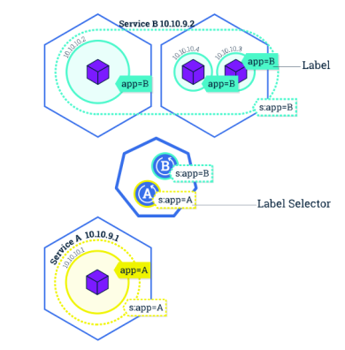
Kubernetes: Label
Key/Value pairs that can be attached to objects to enable a variety of use cases.
Designate objects for specific environments such as development, test and production
Set versions to objects
Set roles or other arbitrary information to classify objects
Can be added or modified at any time
Notes:
-- Add Selectors and Field Selectors, options too for some sample commands like this

Slide 77
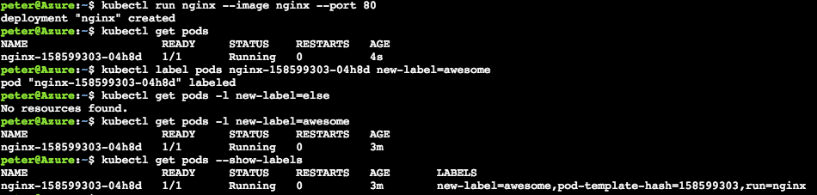
$ kubectl get pod –l name=<label>
Note: Best mechanism to organize Kubernetes objects
labels can be used to provide logical structure
divide by teams, or by environments, or versions
annotations and labels have very subtle difference
$ kubectl create -f helloworld-pod-with-labels.yml
$ kubectl get po --show-labels
Ref:- https://www.linkedin.com/learning/learning-kubernetes/next-steps
Notes:
kubectl run nginx --image nginx --port 80
kubectl get pods
kubectl label pods nginx-158599303-04h8d new-label=awesome
kubectl get pods -l new-label=else
kubectl get pods -l new-label=awesome
kubectl get pods --show-labels
http://kubernetesbyexample.com/labels/

Slide 78
Exercise - 3 (Kubernetes Labels )
Create a series of pods with different labels
Query the pods based on various labels
Delete pods based on certain selectors
https://github.com/abhikbanerjee/Kubernetes_Exercise_Files/blob/master/AWS_labels_usage.md
Ref:- https://www.linkedin.com/learning/learning-kubernetes/next-steps
Notes:
Create a cluster (or reuse a cluster from earlier exercises) and connect to it
Execute the nginx example
https://github.com/kubernetes/kubernetes/blob/master/examples/simple-nginx.md
Some repetition here is intentional. You should be comfortable creating clusters, establishing a connection, verifying its healthy, and then cleaning up resources. This foundation is essential before moving on to advanced concepts

Slide 79
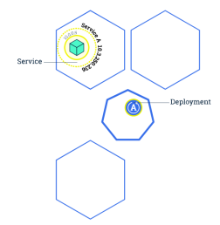
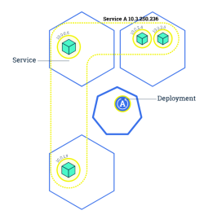
Kubernetes: Scaling
Changing the number of resources to meet a desired state
Accomplished by adjusting the number of replicas in a deployment
Accommodates both scaling up and scaling down to a minimum of 0
Traffic is automatically sent to newly created instances through the service load balancer
Can be used to enable rolling updates without downtime

Slide 80
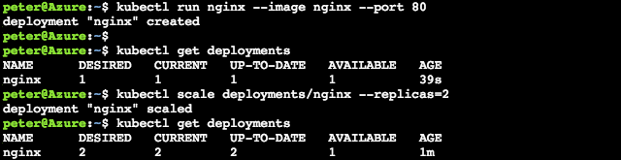
$ kubectl scale deployments/<deployment> --replicas=<new num>
$ kubectl scale deploy/nginx --replicas=4
Note: Make sure to delete the deployments or replicasets when trying to clear out pods. Many a new user has repeated deleted pods and gotten frustrated when they respawn (as the deployments/replicasets are programed to do).
Notes:
kubectl run nginx –image nginx –port 80
kubectl get deployments
kubectl scale deployments/nginx –replicas=2
kubectl get deployments
http://kubernetesbyexample.com/labels/

Slide 81
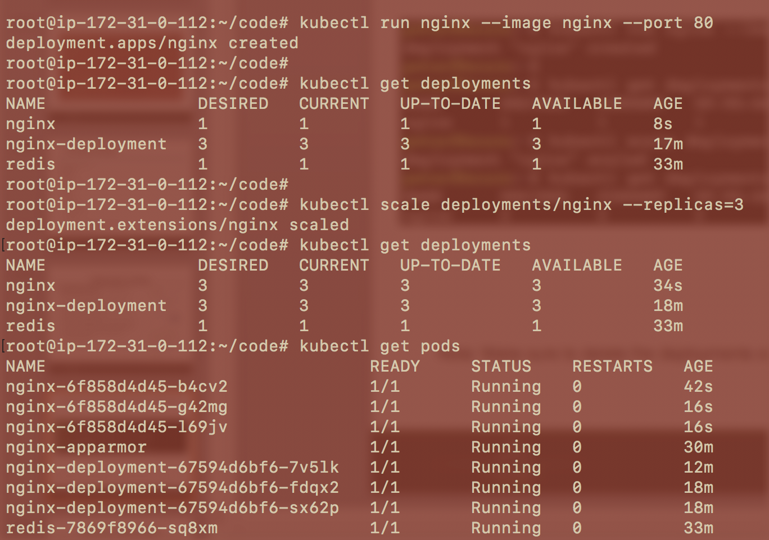
Notes:
kubectl run nginx –image nginx –port 80
kubectl get deployments
kubectl scale deployments/nginx –replicas=2
kubectl get deployments
http://kubernetesbyexample.com/labels/

Slide 82
Kubernetes: AutoScaling
HPA – Horizontal Pod Autoscaler:
Based on memory and CPU utilization by a pod, autoscaling scales up or down the number of pods
$ kubectl autoscale deployment nginx --min=2 --max=10
$ kubectl autoscale deployment nginx-deployment --max=5 --cpu-percent=80
$ kubectl get hpa
$ kubectl get hpa
NAME REFERENCE TARGETS MINPODS MAXPODS REPLICAS AGE
nginx Deployment/nginx <unknown>/80% 1 4 3 12m
nginx-deployment Deployment/nginx-deployment <unknown>/80% 2 5 0 5s

Slide 83
Recap From Yesterday
Basics of Docker
Docker commands Overview
Kubernetes Architecture
Various components of Master, Node
Creation of Pods, Deployments, Services
Creation of Replication Controllers, Replica Sets
Kubernetes Labels and operators
Scaling up & Autoscaling
Notes:
https://github.com/gravitational/workshop/blob/master/k8s101.md
Git clone https://github.com/gravitational/workshop.git
Sections:
Deployments and Replicasets
Services
Back to Deployments
Configuration management basics

Slide 84
Next !!!
Rolling Updates
Basic Troubleshooting
Kubernetes Probing
Kubernetes Volumes, PV, PVC
Kubernetes Logging
Kubernetes Jobs, CronJobs
Kubernetes DaemonSets
Kubernetes StatefulSets
Kubernetes Secrets
Kubernetes Namespaces
Kubernetes Configmaps
Kubernetes Security
Kubernetes Do’s and Don’ts
Notes:
https://github.com/gravitational/workshop/blob/master/k8s101.md
Git clone https://github.com/gravitational/workshop.git
Sections:
Deployments and Replicasets
Services
Back to Deployments
Configuration management basics

Slide 85
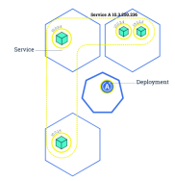
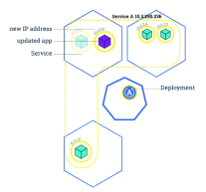
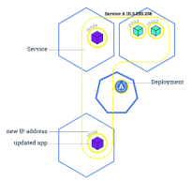
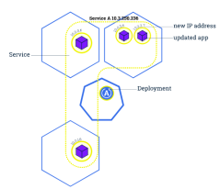
Kubernetes: Rolling Update
Updates the pods in a serial manner will load balancing traffic to available instances
If deployment is exposed publicly, the service will load-balance traffic to only active and available pods
Used to enable zero downtime updates
Allows greater application update frequency
Can also be leveraged to rollback to previous versions

Slide 86
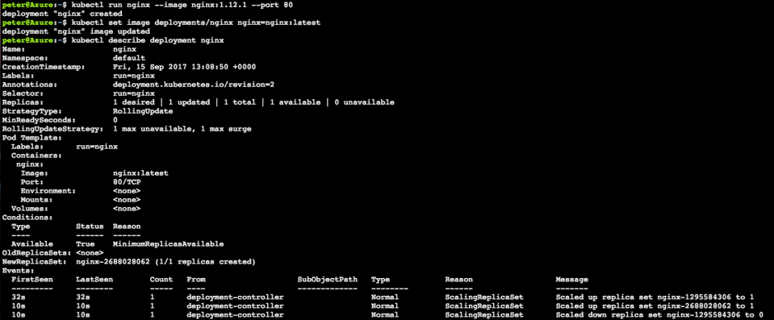
$ kubectl set image <deployment> <new-image>
Note: Rolling updates can also be undone (see next slide)
Notes:
Stand up nginx but with an older version, 1.12.1
1. kubectl run nginx --image nginx:1.12.1 --port 80
Set image to the newer version (latest). This triggers kubernetes to begin a rolling update
2. kubectl set image deployments/nginx nginx=nginx:latest
Observe the newer image has been rolled out
3. kubectl describe deployment nginx

Slide 87
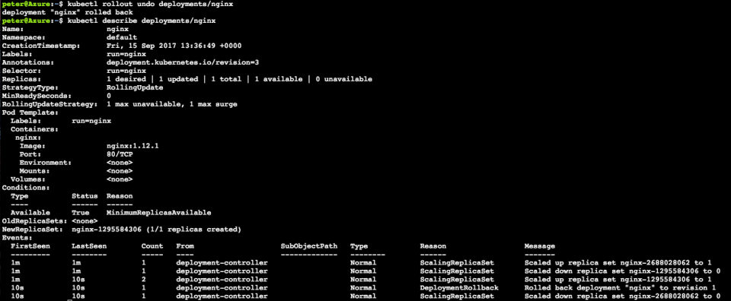
$ kubectl rollout undo <deployment>
Note: Rollbacks can also be also enacted with zero-downtime
Notes:
Roll back to previous version nginx 1.12.1
4. kubectl rollout undo deployments/nginx
Observe changes
5. kubectl describe deployments/nginx

Slide 88
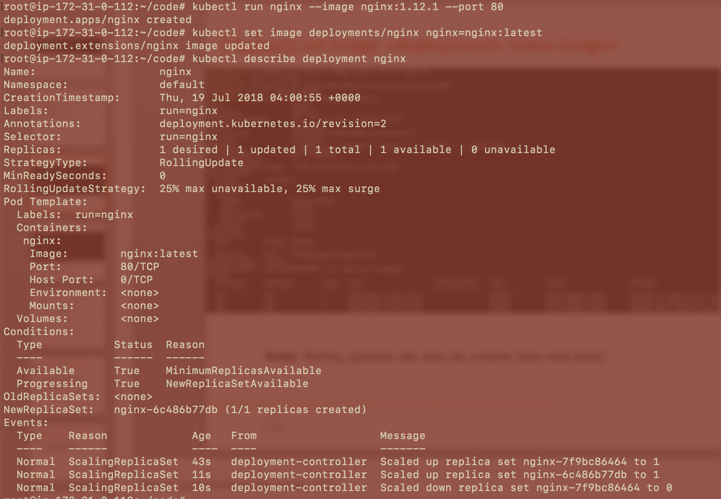
Notes:
Stand up nginx but with an older version, 1.12.1:
1. kubectl run nginx --image nginx:1.12.1 --port 80
Set image to the newer version (latest). This triggers kubernetes to begin a rolling update:
2. kubectl set image deployments/nginx nginx=nginx:latest
Observe the newer image has been rolled out:
3. kubectl describe deployment nginx

Slide 89

Note: Rollbacks can also be also enacted with zero-downtime
kubectl rollout status deployment nginx
kubectl rollout history deployment nginx
kubectl rollout history deployment/nginx --revision=3
kubectl rollout undo deployment/nginx --to-revision <num>
Notes:
Roll back to previous version nginx 1.12.1
4. kubectl rollout undo deployments/nginx
Observe changes
5. kubectl describe deployments/nginx

Slide 90
Exercise 4 - (scaling, Auto-scaling, roll out)
For a previously created deployment scale the number of replicas
see the difference in replicasets, pods , and see with a describe
Rolling update, undo and see the changes in replica sets
https://github.com/abhikbanerjee/Kubernetes_Exercise_Files/blob/master/AWS_scaling_roll_out.md
Ref:- https://www.linkedin.com/learning/learning-kubernetes/next-steps
https://container-solutions.com/kubernetes-deployment-strategies/
https://github.com/ContainerSolutions/k8s-deployment-strategies
https://container-solutions.com/deployment-strategies/
Notes:
https://github.com/gravitational/workshop/blob/master/k8s101.md
Git clone https://github.com/gravitational/workshop.git
Sections:
Deployments and Replica Sets
Services
Back to Deployments
Configuration management basics

Slide 91
Deployment Strategies
Recreate
Ramped (Similar to Rolling Updates)
Blue - Green Deployment
Canary Deployment
A/B Testing
Shadow Deployments
Ref:- https://www.linkedin.com/learning/learning-kubernetes/next-steps
https://container-solutions.com/kubernetes-deployment-strategies/
https://github.com/ContainerSolutions/k8s-deployment-strategies
https://container-solutions.com/deployment-strategies/
Notes:
https://github.com/gravitational/workshop/blob/master/k8s101.md
Git clone https://github.com/gravitational/workshop.git
Sections:
Deployments and Replica Sets
Services
Back to Deployments
Configuration management basics

Slide 92

Kubernetes: Edit
Edit the configuration of a running entity
How a real world deployment looks like we can do a demo -
$ kubectl create -f guestbook.yaml
Ref:- https://www.linkedin.com/learning/learning-kubernetes/next-steps

Slide 93


Kubernetes: Pod Priority
Set the priority for pod scheduling, cannot ask never to kill a pod
Notes:
-- can have any priority between 1 to 1 billion - 10^9, because 1 billion 1 is assigned to kube-system resources

Slide 94

Basic Troubleshooting
Describe is your friend , start from deployment,
check for logs of the specific pods using kubectl logs pod_name
kubectl exec -it pod_name /bin/bash - if there are multiple containers in a single pod, we may need to use -c pod_name (like helloworld)

Slide 95
Basic Troubleshooting - An example
$ kubectl create -f https://raw.githubusercontent.com/abhikbanerjee/Kubernetes_Exercise_Files/master/helper_yaml_files/Ex_common_debugging/helloworld-with-bad-pod.yaml
$ kubectl get po,deploy,svc
$ kubectl describe <pod_name>
$ kubectl logs <pod_name>
$ kubectl exec -it <pod_name> /bin/bash
$ ps -ef
$ kubectl exec -it <pod_name> -c helloworld /bin/bash
$ kubectl get <pod_name> -o wide, json, yaml (can use -l option)
Use sample_retail_infra.yaml
$ kubectl get pods --sort-by=.metadata.name -o wide --all-namespaces
$ kubectl get pods -o=jsonpath"{..images}" -l env=staging -n cart
$ kubectl delete pods -n cart --all (delete all the pods in cart namespace, using --all we want to be sure we want to delete everything)
$ kubectl get pods -n cart -w (watch the deletion process for a while)
we can add --grace-period=0 --force (doesn’t wait for the pod to do the clean up , and force deletes the pods)
Ref:- https://www.linkedin.com/learning/learning-kubernetes/next-steps

Slide 96
Kubernetes: Probes
Kubernetes Probe - The kubelet uses liveness probes and readiness probe to check status of containers.
Kubernetes uses 2 different Probes :-
Liveness Probe : uses liveness probes to know when to restart a Container. Liveness probe could catch a deadlock, where an application is running, but unable to make progress. Restarting a Container in such a state can help to make the application more available despite bugs.
Readiness Probe : The kubelet uses readiness probes to know when a Container is ready to start accepting traffic. A Pod is considered ready when all of its Containers are ready. One use of this signal is to control which Pods are used as backends for Services. When a Pod is not ready, it is removed from Service load balancers

Slide 97
Exercise 5 - (Liveness and Readiness Probes )
learn the concepts of Liveness and Readiness Probes.
See the example of CrashLoopBackOff
https://github.com/abhikbanerjee/Kubernetes_Exercise_Files/blob/master/AWS_liveness_readiness_probe.md
Ref:- https://www.linkedin.com/learning/learning-kubernetes/next-steps
Notes:
https://github.com/gravitational/workshop/blob/master/k8s101.md
Git clone https://github.com/gravitational/workshop.git
Sections:
Deployments and Replicasets
Services
Back to Deployments
Configuration management basics

Slide 98
Kubernetes: Volumes
On-disk files in a container are the simplest place for an application to write
data, but this approach has drawbacks. The files are lost when the container crashes or stops for any other reason. Furthermore, files within a container are inaccessible to other containers running in the same Pod. The Kubernetes Volume abstraction addresses both of these issues.
A directory accessible to all containers in a pod
Volumes out live containers that run within a pod
May be passed between pods
Data is preserved across container restarts

Slide 99

Kubernetes: Volumes
Note: Volumes are based on a wide assortment of underlying storage provides. Every major public cloud (including Azure) has several options for volume storage
Notes:
1. kubectl create -f https://raw.githubusercontent.com/mhausenblas/kbe/master/specs/volumes/pod.yaml
Shell into the first pod
2. kubectl exec sharevol -c c1 -i -t -- bash
Write data to an ‘xchange’ file
3. mount | grep xchange
4. echo 'some data' > /tmp/xchange/data
Exit out of container
5. exit
Now shell into the 2nd container
6. kubectl exec sharevol -c c2 -i -t – bash
7. mount | grep /tmp/data
8. cat /tmp/data/data
View the whole pod.yaml file here: https://github.com/openshift-evangelists/kbe/blob/master/specs/volumes/pod.yaml
Kubernetes by example Volumes: http://kubernetesbyexample.com/volumes/

Slide 100
Kubernetes: Persistent Volume
Persistent storage in a cluster
Separate from PersistentVolumeClaim, which is a request for storage.
May be created ahead of time in a static manner for use by a cluster
May be created dynamically from available, unclaimed resources
May be freed and passed from user to user so care should be taken to delete contents when done with use
Critical for Stateful containers

Slide 101
Kubernetes: Persistent Volumes
PV: Storage in the cluster that has been provisioned by an administrator (static or dynamic) and is independent of any individual pod that uses the PV.
Following volumes are supported by Kubernetes:
GCEPersistentDisk ; AWSElasticBlockStore
AzureFile ; AzureDisk
FC (Fibre Channel) ; FlexVolume
Flocker ; NFS
iSCSI ; RBD (Ceph Block Device)
CephFS ; Cinder (OpenStack block storage)
Glusterfs ; VsphereVolume
Portworx Volumes ; ScaleIO Volumes
StorageOS

Slide 102
Kubernetes: Persistent Volumes
apiVersion: v1
kind: PersistentVolume
metadata:
name: pv0003
spec:
capacity:
storage: 5Gi
volumeMode: Filesystem
accessModes:
- ReadWriteOnce
persistentVolumeReclaimPolicy: Recycle
storageClassName: slow
mountOptions:
- hard
- nfsvers=4.1
nfs:
path: /tmp
server: 172.17.0.2

Slide 103

Kubernetes: Persistent Volume Claims
PVC: Request for a storage by a user, it is similar to pod and it can request specific size and access modes (e.g., can be mounted once read/write or many times read-only).
https://github.com/abhikbanerjee/Kubernetes_Exercise_Files/blob/master/helper_yaml_files/pvc.yaml
https://github.com/abhikbanerjee/Kubernetes_Exercise_Files/blob/master/helper_yaml_files/deploy_pvc.yaml

Slide 104
Exercise 6 - (Volume, PV, PVC)
create pods,PV and PVC
Experiment with creating end to end application, mount volume, read from shared pod
Fix a bug
6.1 Exercise of Volume
https://github.com/abhikbanerjee/Kubernetes_Exercise_Files/blob/master/AWS_Creating_Volume.md
6.2 Exercise on PV, PVC
https://github.com/abhikbanerjee/Kubernetes_Exercise_Files/blob/master/AWS_Creating_Persistent_Volume.md
Notes:
https://github.com/gravitational/workshop/blob/master/k8s101.md
Git clone https://github.com/gravitational/workshop.git
Sections:
Deployments and Replicasets
Services
Back to Deployments
Configuration management basics

Slide 105
Kubernetes: Logging
Aggregate, access and print logs from containers
Logs can be accessed from a currently run container or any number or previously run containers, accessed by container name
Containerized apps write logs to stdout and stderr
Cluster level logging can be performed using several different techniques including node level agents, container sidecars, or even having containers push directly to an application
Node level logging is the most common approach, typically using Elasticsearch.
Notes:
Print Logs
Kubectl logs logme
Stream logs
Kubectl logs –f logme

Slide 106


Kubernetes: Logging
Note: An external system can perform the log rotation by calling logrotate, which would result in kubectl logs returning an empty result
Notes:
Create a loging pod
1. kubectl create -f https://raw.githubusercontent.com/mhausenblas/kbe/master/specs/logging/pod.yaml
Grab the last few lines of logs
2. kubectl logs --tail=5 logme -c gen
Grab a stream of the logs
3. kubectl logs -f --since=10s logme -c gen
Clean up
4. kubectl delete -f https://raw.githubusercontent.com/mhausenblas/kbe/master/specs/logging/pod.yaml
Now launch a container that performs an action and then exits. Give it a minute or so to close out
5. kubectl create -f https://raw.githubusercontent.com/mhausenblas/kbe/master/specs/logging/oneshotpod.yaml
Now output the logs of this container
6. kubectl logs -p oneshot -c gen
Clean up
7. kubectl delete -f https://raw.githubusercontent.com/mhausenblas/kbe/master/specs/logging/oneshotpod.yaml
http://kubernetesbyexample.com/logging/
kubectl create -f https://raw.githubusercontent.com/mhausenblas/kbe/master/specs/logging/pod.yaml
Grab the last few lines of logs
kubectl logs --tail=5 po/logme
Grab a stream of the logs
kubectl logs ‐f ‐‐since=10s po/logme

Slide 107
Exercise 7 - Kubernetes Logging
Create a logging pd
View the logs
Create one-shot pod
https://github.com/abhikbanerjee/Kubernetes_Exercise_Files/blob/master/AWS_Kubernetes_Logging.md
Notes:
https://github.com/gravitational/workshop/blob/master/k8s101.md
Git clone https://github.com/gravitational/workshop.git
Sections:
Deployments and Replicasets
Services
Back to Deployments
Configuration management basics

Slide 108
Exercise 8 - ElasticSearch example
Real world example for hosting ElasticSearch (ES)
Deploy , scale the ES application
Create Index and Search
https://github.com/abhikbanerjee/Kubernetes_Exercise_Files/blob/master/AWS_ElasticSearch_Kubernetes.md
Notes:
https://github.com/gravitational/workshop/blob/master/k8s101.md
Git clone https://github.com/gravitational/workshop.git
Sections:
Deployments and Replicasets
Services
Back to Deployments
Configuration management basics

Slide 109
Kubernetes: Jobs and Cron Jobs
Jobs - Creates one or more pods and ensures that a specified number of them successfully terminate. As pods successfully complete, the job tracks the successful completions. When a specified number of successful completions is reached, the job itself is complete. Deleting a Job will cleanup the pods it created.
Cron Job - A Cron Job creates Jobs on a time-based schedule. One Cron Job object is like one line of a crontab (cron table) file. It runs a job periodically on a given schedule
Notes:
https://kubernetes.io/docs/concepts/workloads/controllers/statefulset/

Slide 110


Kubernetes: Jobs and Cron Jobs
Notes:
https://kubernetes.io/docs/concepts/workloads/controllers/statefulset/

Slide 111
Exercise 9 - Jobs and Cron jobs
Create Job and check the logs
Create a Cron Job,
Edit the Cron Job
https://github.com/abhikbanerjee/Kubernetes_Exercise_Files/blob/master/AWS_job_cronjob.md
Ref:- https://www.linkedin.com/learning/learning-kubernetes/next-steps
Notes:
https://github.com/gravitational/workshop/blob/master/k8s101.md
Git clone https://github.com/gravitational/workshop.git
Sections:
Deployments and Replicasets
Services
Back to Deployments
Configuration management basics

Slide 112

Kubernetes: Daemon Sets
Daemon Sets - This makes sure all nodes run the copy of a specific pod . As nodes are added to the cluster, Pods are added to them. As nodes are removed from the cluster, those Pods are garbage collected. Deleting a DaemonSet will clean up the Pods it created.
running a cluster storage daemon, such as glusterd, ceph, on each node.
running a logs collection daemon on every node, such as fluentd or logstash.
Ref:- https://kubernetes.io/docs/concepts/workloads/controllers/daemonset/
Notes:
https://kubernetes.io/docs/concepts/workloads/controllers/statefulset/

Slide 113
Exercise 10 - DaemonSets
Create a DaemonSet
Check the Pods, and nodes
See on creating different labels, how it schedules the daemonsets and pods
https://github.com/abhikbanerjee/Kubernetes_Exercise_Files/blob/master/AWS_Daemonset.md
Ref:- https://www.linkedin.com/learning/learning-kubernetes/next-steps
Notes:
https://github.com/gravitational/workshop/blob/master/k8s101.md
Git clone https://github.com/gravitational/workshop.git
Sections:
Deployments and Replicasets
Services
Back to Deployments
Configuration management basics

Slide 114
Kubernetes: Stateful Sets
Stateful Sets manage the deployment and scaling of a set of Pods, and provides guarantees about the ordering and uniqueness of these Pods.
Like a Deployment, a Stateful Set manages Pods that are based on an identical container spec. Unlike a Deployment, a StatefulSet maintains a sticky identity for each of their Pods. These pods are created from the same spec, but are not interchangeable: each has a persistent identifier that it maintains across any rescheduling.
A StatefulSet operates under the same pattern as any other Controller. You define your desired state in a StatefulSet object, and the StatefulSet controller makes any necessary updates to get there from the current state.
Notes:
https://kubernetes.io/docs/concepts/workloads/controllers/statefulset/

Slide 115

Kubernetes: Stateful Sets
StatefulSets are valuable for applications that require one or more of the following:
Stable, unique network identifiers.
Stable, persistent storage.
Ordered, graceful deployment and scaling.
Ordered, graceful deletion and termination.
Ordered, automated rolling updates.
Notes:
https://kubernetes.io/docs/concepts/workloads/controllers/statefulset/

Slide 116
Exercise 11 - Stateful Sets
Create a Stateful Sets
use Zookeeper to demonstrate that
https://github.com/abhikbanerjee/Kubernetes_Exercise_Files/blob/master/AWS_statefulsets.md
Ref:- https://www.linkedin.com/learning/learning-kubernetes/next-steps
Notes:
https://github.com/gravitational/workshop/blob/master/k8s101.md
Git clone https://github.com/gravitational/workshop.git
Sections:
Deployments and Replicasets
Services
Back to Deployments
Configuration management basics

Slide 117

Kubernetes: Namespace
Resources are segmented within namespaces
Sandbox per developer for example
Pods will route dns to default (own) namespace
The same app could run independently in different namespaces
Namespaces create an excellent mechanism to subdivide resources and provide isolation. This enables using a cluster for multiple projects or multiple teams

Slide 118

Kubernetes: Namespace
$ kubectl get po,deploy,svc,rs --all-namespaces
$ kubectl create -f simple_pod.yaml -n abhik_namespace
$ kubectl get po -o wide
$ kubectl get po -o wide -n abhik_namespace
$ kubectl delete po simple_pod
$ kubectl delete po simple_pod -n abhik_namespace
Notes:
Get default namespaces
1. kubectl get ns
Create a ‘test’ namespace
2. kubectl create -f https://raw.githubusercontent.com/mhausenblas/kbe/master/specs/ns/ns.yaml
Recheck namespaces and observe
3. kubectl get ns
Now create a pod in this new namespace
4. kubectl create --namespace=test -f https://raw.githubusercontent.com/mhausenblas/kbe/master/specs/ns/pod.yaml
Check pods in this new namespace
5. kubectl get pods --namespace=test
show the resource-quota example and exercise -
https://kubernetes.io/docs/tasks/administer-cluster/manage-resources/quota-memory-cpu-namespace/
also have a namepsace example mini
--

Slide 119
Exercise 12 - Namespace
Create a namespace
check various objects in different namespaces
Can create or delete objects from a specific namespace
Can use previous examples
$ kubectl get po,deploy,svc,rs --all-namespaces
$ kubectl create -f simple_pod.yaml -n abhik_namespace
$ kubectl get po -o wide
$ kubectl get po -o wide -n abhik_namespace
$ kubectl delete po simple_pod
$ kubectl delete po simple_pod -n abhik_namespace
$ kubectl api-resources --namespaced=false (shows resources which don’t fall under a namespace)
Notes:
https://github.com/gravitational/workshop/blob/master/k8s101.md
Git clone https://github.com/gravitational/workshop.git
Sections:
Deployments and Replicasets
Services
Back to Deployments
Configuration management basics

Slide 120

Kubernetes: Secrets
An object that contains a small amount of sensitive data such as a password, token or key.
According to 12-factor configuration comes from the environment
Config is everything that is likely to vary between deployments
Can be used by pods and the underlying Kubelet when pulling images
Secrets belong to a specific Kubernetes Namespace
Secret size cannot exceed 1MB
Notes:
Additional Info:
https://developer.ibm.com/recipes/tutorials/use-kubernetes-secrets-to-make-your-app-portable-across-clouds/

Slide 121
Kubernetes: Secrets
$ kubectl create secret generic apikey --from-literal=api_key=1234567 (create secrets for passwords)
$ kubectl get secrets
$ kubectl get secret/apikey -o yaml and kubectl get secret/apikey lets us inspect the secret key
$ kubectl create -f secretreader-deployment.yaml, check if the deployment and pods are running
$ kubectl logs pod/secretreader-598bc7845c-7kqkk
$ echo -n secret_base_64_key | base64 --decode
Notes:
http://kubernetesbyexample.com/secrets/
1. echo -n "A19fh68B001j" > ./apikey.txt
2. kubectl create secret generic apikey --from-file=./apikey.txt
3. kubectl describe secrets/apikey
4. kubectl create -f https://raw.githubusercontent.com/mhausenblas/kbe/master/specs/secrets/pod.yaml
5. kubectl exec consumesec -c shell -i -t – bash
6. mount | grep apikey
7. cat /tmp/apikey/apikey.txt

Slide 122
Exercise 13 - Secrets
Create a Secret
Check the secret from the object and from the logs
Also check the base 64 decoder for the secret
https://github.com/abhikbanerjee/Kubernetes_Exercise_Files/blob/master/AWS_Application_Secrets.md
Notes:
https://github.com/gravitational/workshop/blob/master/k8s101.md
Git clone https://github.com/gravitational/workshop.git
Sections:
Deployments and Replicasets
Services
Back to Deployments
Configuration management basics

Slide 123


Kubernetes: Configmap
A set of key-value pairs that serve as configuration data for pods. They solve the problem of how to pass config data such as environment variables to pods.
Config maps are commonly composed of:
Command line arguments
Environment variables
Files in a volume
Config maps function similar to secrets, but values are stored as strings and are more readily readable.
Notes:
http://pwittrock.github.io/docs/user-guide/configmap/
Extra resources:
https://docs.openshift.org/latest/dev_guide/configmaps.html

Slide 124

Kubernetes: Config Map
Notes:
http://pwittrock.github.io/docs/user-guide/configmap/
Extra resources:
https://docs.openshift.org/latest/dev_guide/configmaps.html

Slide 125
Kubernetes: Config Map
apiVersion: v1
kind: Pod
metadata:
name: pod-with-cm
spec:
containers:
- name: test-container
image: k8s.gcr.io/busybox
command: [ "/bin/sh", "-c", "env" ]
env:
- name: SPECIAL_LEVEL_KEY
valueFrom:
configMapKeyRef:
name: test-cm
key: key1
restartPolicy: Never
apiVersion: v1
kind: ConfigMap
metadata:
name: test-cm
labels:
name: test-cm
data:
key1: value1
key2: value2
Notes:
http://pwittrock.github.io/docs/user-guide/configmap/
Extra resources:
https://docs.openshift.org/latest/dev_guide/configmaps.html

Slide 126
Exercise 14 - Config Maps
Create a deployment which uses hard coded value for log-level
Create a Config Map
Use the Config map inside a deployment
https://github.com/abhikbanerjee/Kubernetes_Exercise_Files/blob/master/AWS_configmap.md
Ref:- https://www.linkedin.com/learning/learning-kubernetes/next-steps
Notes:
https://github.com/gravitational/workshop/blob/master/k8s101.md
Git clone https://github.com/gravitational/workshop.git
Sections:
Deployments and Replicasets
Services
Back to Deployments
Configuration management basics

Slide 127

Kubernetes Tools : Dashboard
Kubernetes Dashboard - default add on provided by kubernetes
Easy to check deployments, edit deployments, scale deployments, and check cpu, memory usages
https://github.com/abhikbanerjee/Kubernetes_Exercise_Files/blob/master/AWS_setup_files/Kubernetes_Setup_AWS.md

Slide 128

Kubernetes Tools : CAdvisor, Heapster, Prometheus
Ref:- https://www.linkedin.com/learning/learning-kubernetes/next-steps

Slide 129
Kubernetes Tools : Prometheus
Prometheus is an open source time series monitoring and alerting toolkit (originally written by SoundCloud). It is sponsored by the Cloud Native Computing Foundation and was the second project to be adopted after Kubernetes.
Dimensional Data
Powerful Queries
Visualization Tools
Efficient Storage
Alerting System

Slide 130

Kubernetes Tools : Grafana
Grafana uses Prometheus, CAdvisor and Heapster and applies better visualization
Ref:- https://www.linkedin.com/learning/learning-kubernetes/next-steps

Slide 131
Exercise 15 - Prometheus
Stand up Prometheus
Gather and monitor metrics
https://github.com/abhikbanerjee/Kubernetes_Exercise_Files/blob/master/AWS_Configure_Prometheus.md
Notes:
https://github.com/gravitational/workshop/blob/master/k8s101.md
Git clone https://github.com/gravitational/workshop.git
Sections:
Deployments and Replicasets
Services
Back to Deployments
Configuration management basics

Slide 132

Kubernetes Security
Ref:- https://kubernetes.io/docs/concepts/overview/object-management-kubectl/declarative-config/

Slide 133

Authentication Example

Slide 134

Authorization Example

Slide 135
Admission Control Example
An admission controller is a piece of code that intercepts requests to the Kubernetes API server prior to persistence of the object, but after the request is authenticated and authorized.
may only be configured by the cluster administrator.
Many advanced features in Kubernetes require an admission controller to be enabled in order to properly support the feature
Admission controllers may be “validating”, “mutating”, or both. Mutating controllers may modify the objects they admit; validating controllers may not.
Ref:- https://kubernetes.io/docs/reference/access-authn-authz/admission-controllers/#what-does-each-admission-controller-do

Slide 136

Kubernetes Networking
Kubernetes assumes that pods can communicate with other pods, regardless of host
Kubernetes requires
All containers to communicate with other containers without NAT
All nodes can communicate with all containers without NAT
IP that container sees itself as is the same as others see it
In practice, Kubernetes cannot be installed simply with Docker. It usually requires a networking layer such as Weave, Flannel, etc
Notes:
Additional Info:
https://jvns.ca/blog/2016/12/22/container-networking/
Add more slides on Networking, and Access controls - Authentication and Authorization Architecture

Slide 137
Kubernetes Do’s and Don’ts
Decide what is the best setup for your kubernetes environment
For easy provisioning and testing Minikube comes handy, so does Kubeadm
Use namespaces and Labels for efficient usage of defining your objects
Always use config files, or Declarative syntax depending on the teams updating configs
Use Resource quotas , for better management of hardware resources - https://kubernetes.io/docs/concepts/policy/resource-quotas/
For quick testing Node Ports are good, but Load Balancers and Ingress are better options for production level settings
Logs should always go to PV’s and for better management use PVCs
Notes:
Additional Info:
https://jvns.ca/blog/2016/12/22/container-networking/
Add more slides on Networking, and Access controls - Authentication and Authorization Architecture

Slide 138
Kubernetes Do’s and Don’ts
Microservices Architecture follow the 12-step rule
Always use controllers , rather than pods
Always version control your code and config files
if in confusion use fluentd for logging
Cluster Federation helps to sync resources into multiple clusters , cross cluster discovery- Kubefed
Kompose converts docker compose file into kubernetes objects like deployments, and services,
Helm - streamlines installation and management of kubernetes cluster, its like the package manager for kubernetes, contains chart.yaml, template and values.yaml, provides 3 most important things - helps in creating templates, versioning and rolled back and tracked, application packaging.
Kubernetes Documentation are the best resource whenever in doubt. - https://kubernetes.io/docs/reference/ and https://kubernetes.io/docs/concepts/
Notes:
Additional Info:
https://jvns.ca/blog/2016/12/22/container-networking/
Add more slides on Networking, and Access controls - Authentication and Authorization Architecture

Slide 139
Kubernetes - Multiple Nodes Demo
Create a Node (EC2) and join the master
We should see 2 nodes now
Lets create a deployment with 3 replicas and see the placement of pods
lets scale the deployment and see how it does
We can extend this to try daemonsets and other concepts to validate our understanding

